Slide 1
My Research

Slide 2
Nitric Oxide (NO)
Smallest known signaling molecule
Lipid soluble
Very short lived
Natural form gas
O₂
L-arginine NO + L-citrulline
Nitric Oxide
Synthase (NOS)
Nitrite
Nitrate
Notes:
Nitric oxide is smallest signalling molecule , NO is lipid soluble, half life of NO is 3 seconds, natural form of NO is gas.
NOS enzyme produce NO from l arginine in the presence of oxygen. Since half life very short, NO is oxidized to nitrite and nitrate.

Slide 3
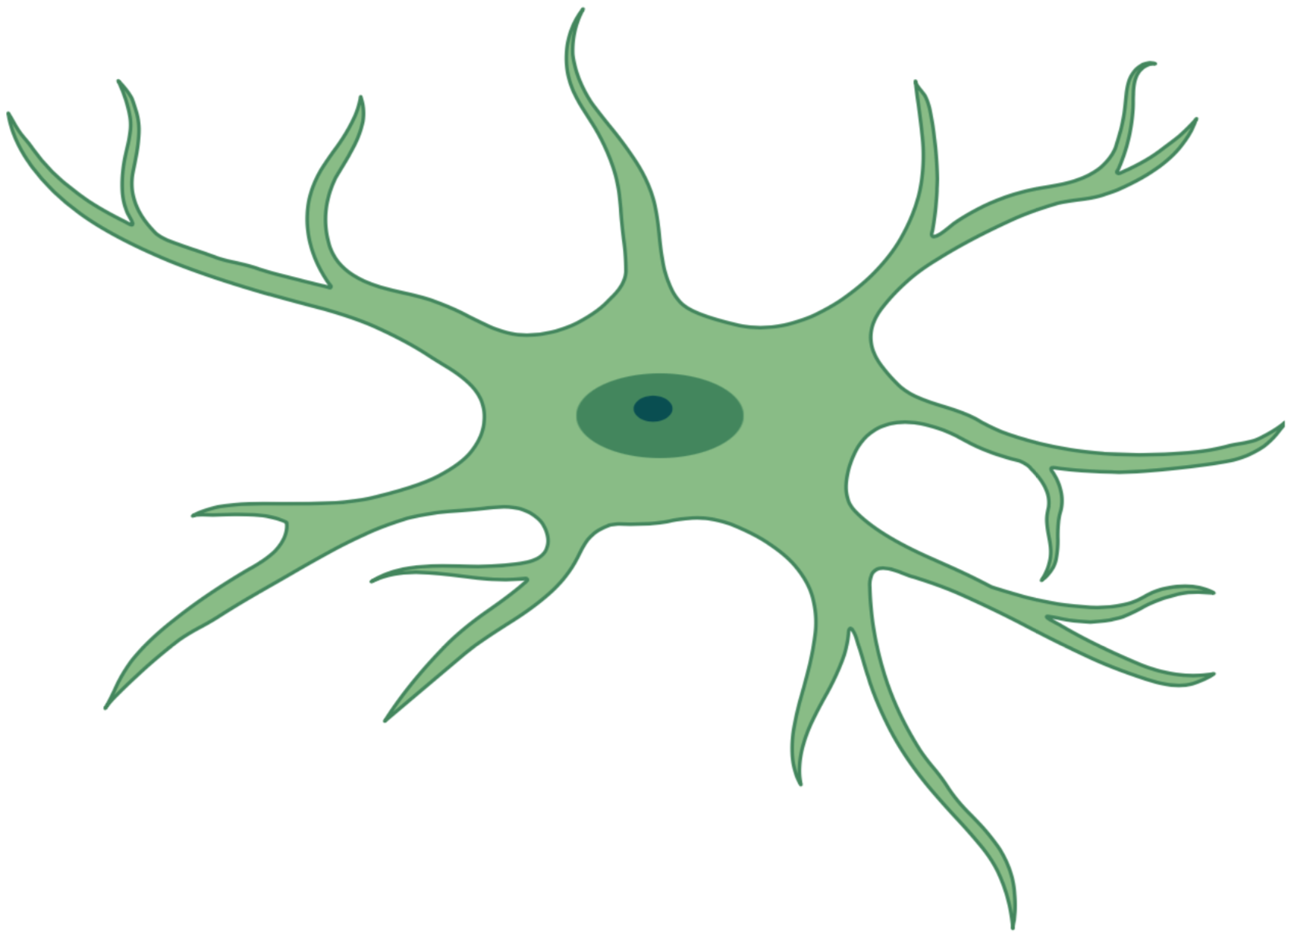
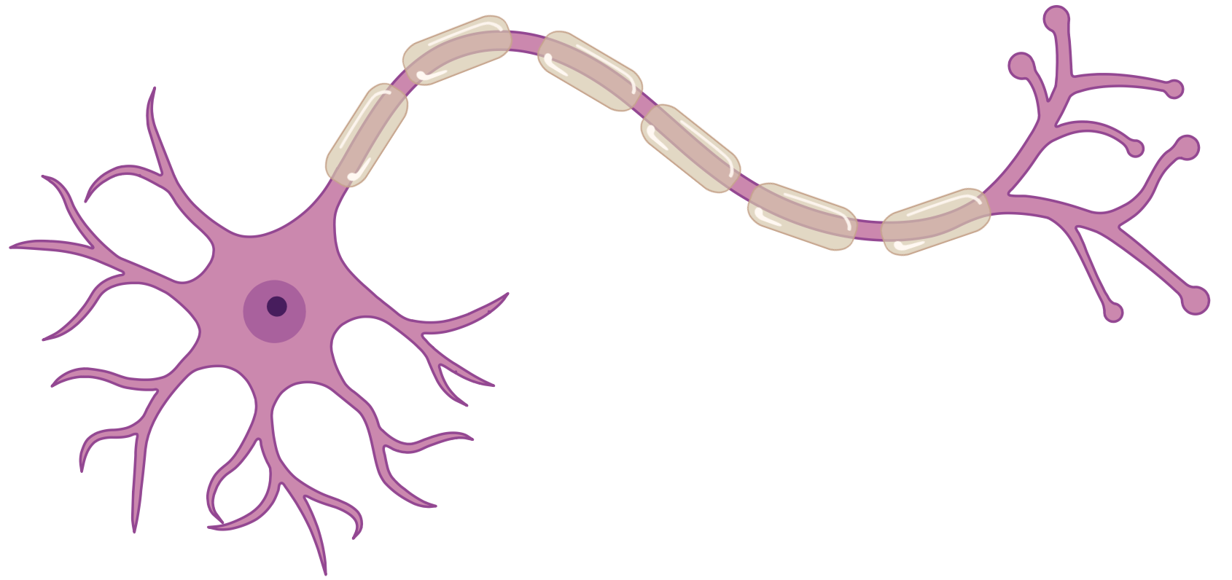
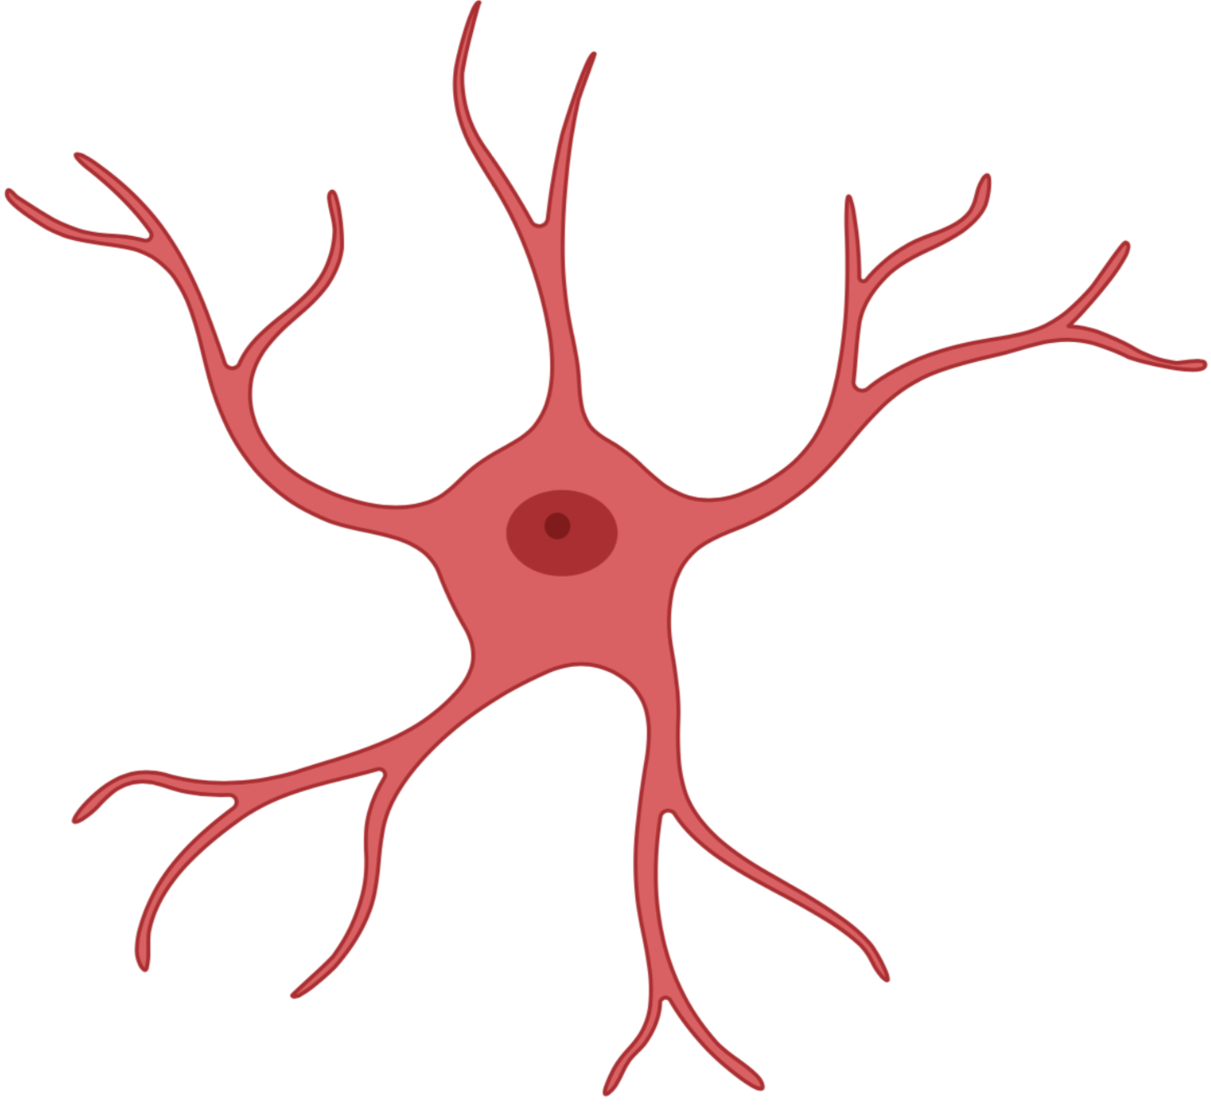




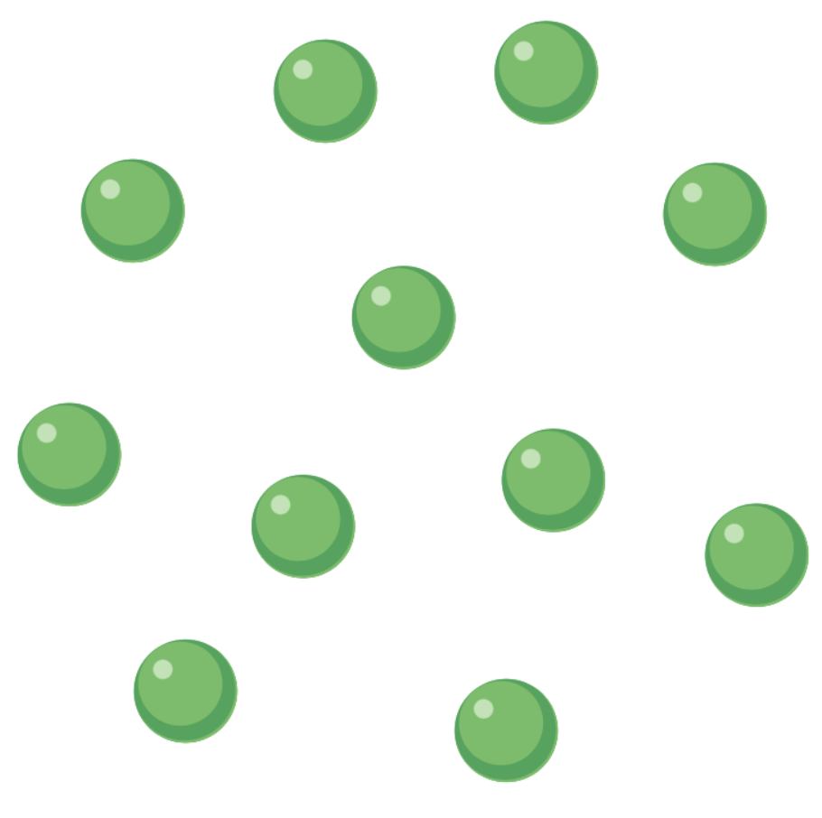

Nitric Oxide (NO)
Endothelial cell
Microglia
Neuron
Astrocyte
eNOS
nNOS
iNOS
NO
NO
NO
Notes:
there are 3 isoform of NOS.
NOS-1 also called neuronal Nitric oxide synthase, found in neuron, skeletal muscle, vascular smooth muscle. Constitutively expressed,:: require calcium influx in the cell , MW-150-160
NOS-2 also called inducible Nitric oxide synthase, found in macrophage, smooth muscle, astrocytes, transcriptionally induced, active at nano molar calcium,::: MW-125-135
NOS-3 also called endothelial Nitric oxide synthase, found in endothelial cells, neurons, ::: Constitutively expressed, require calcium influx in the ce, MW-133
nNOS VASCULAR SMOOTH muscle

Slide 4
Role of NO in Stroke
Endothelial cell
Microglia
Astrocyte
eNOS
iNOS
NO
NO
ONOO-
Neuroprotective
Neurotoxic
Notes:
eNOS derived NO considered neuroprotective.
But when iNOS is induced it might produce 100 to 1000 times more nitric oxide than eNOS.
This excessiove nitric oxide convert to peroxynitrite. Which is neurotoxic
So enos and inos play opposite role in stroke.
Peroxinitrite onoo-
Read details

Slide 5
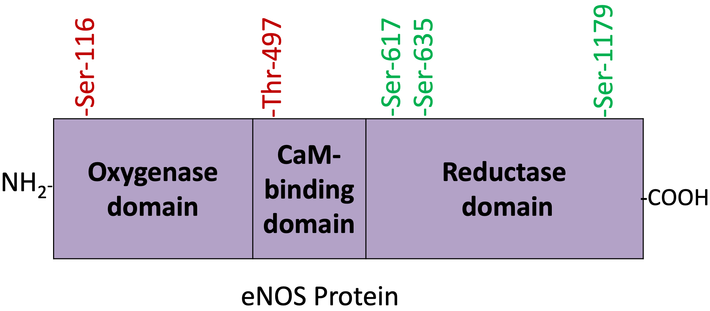
How is NOS Activity Regulated?
eNOS activity is regulated by a complex series of phosphorylation.
Notes:
How the enos activity is regulated?
eNOS activity is regulated by a complex series of phosphorylations.
When phosphorylation occur in serine 116 or threonine 497 (bovine here), activity decreases.
When phosphorylation occur in serine 617 or serine 635 or serine 1179 (bovine here), activity increases.

Slide 6
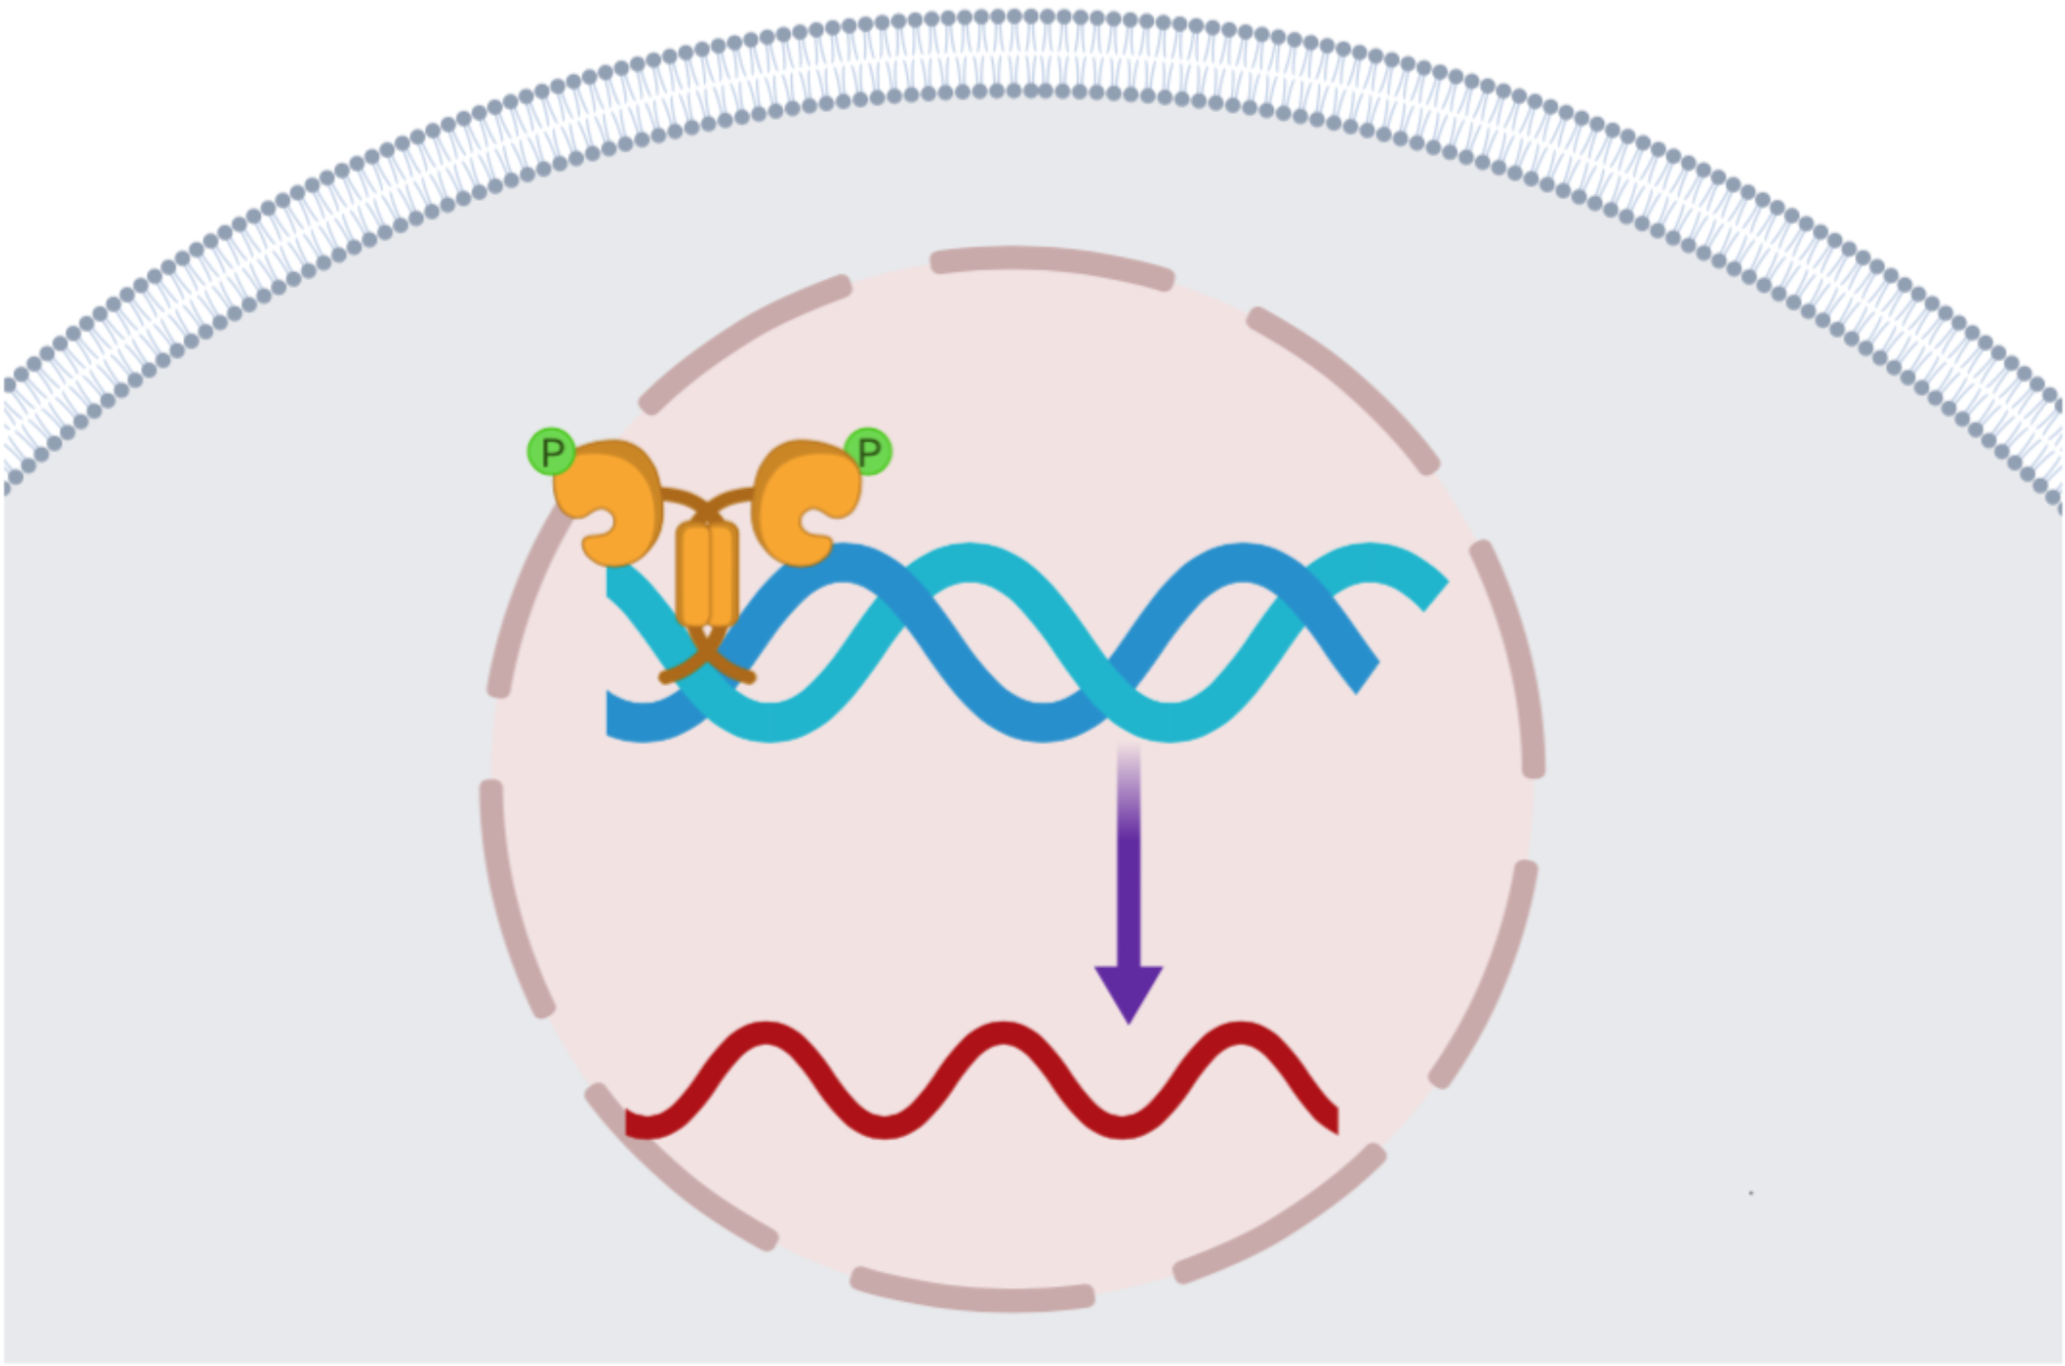
How is NOS Activity Regulated?
iNOS activity is mostly regulated at the transcriptional level.
Transcription
Factor
iNOS Gene
iNOS mRNA
Notes:
.
iNOS activity is mostly regulated at the transcriptional level. May be
Cytokines, including TNFα, increase iNOS transcription.

Slide 7
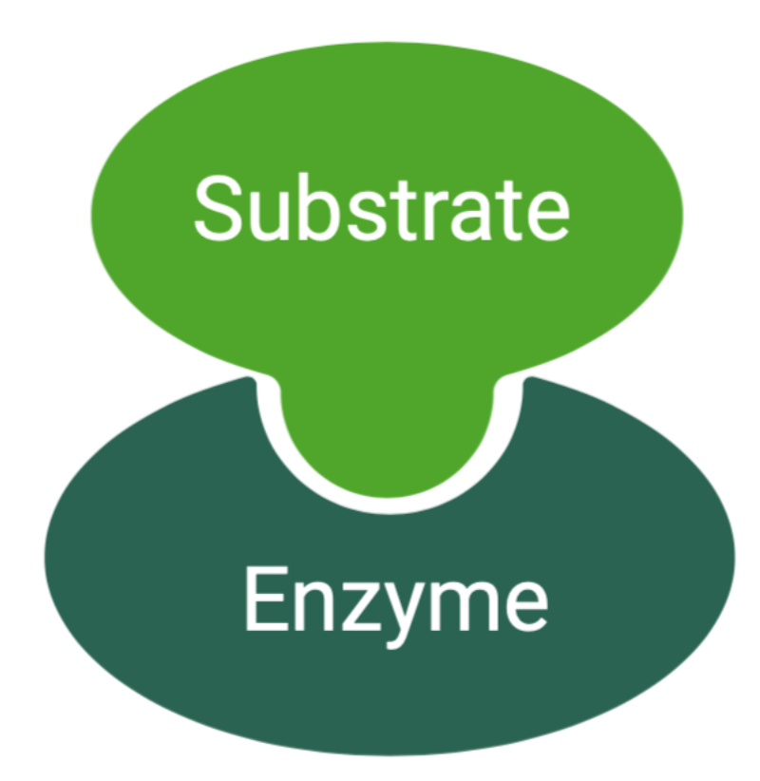
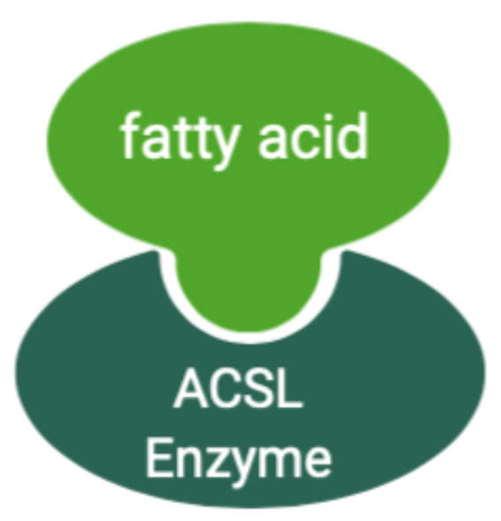
What is ACSL?
Long chain fatty acyl-CoA synthetases (ACSL) enzymes.
Activate fatty acid with chain length of 12 to 20 carbon atoms.
5 isoforms ( ACSL1, ACSL3, ACSL4, ACSL5 and ACSL6).
Notes:
Acyl coa synthetase enzyme family can be divided into 5 sub family-
short chain 2-4, medium chain 4-12, long chain 12-20, bubblegum 14-24, very long chain 18-26
ACSL are necessary for fatty acid degradation , phospholipid remodeling and production of long acyl-coa ester that regulate various physiological process.
ACSL catalyzes the ligation of fatty acids to coenzyme A, the first and rate-limiting step in fatty acid utilization

Slide 8

ATP
Coenzyme A
Fatty Acid
ACSL
Fatty acyl CoA
AMP
Notes:
ACSL catalyzes the ligation of fatty acids to coenzyme A, the first and rate-limiting step in fatty acid utilization

Slide 9
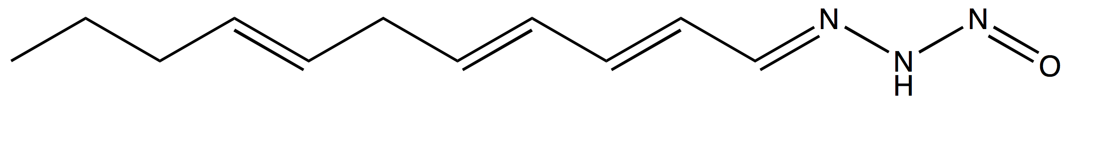
Coenzyme A
Fatty Acid
ACSL 1,3,4
Fatty acyl CoA
Triacsin C
Notes:
Traicsin c inhibits acsl 1,3,4:::: so the fatty acid does not activate to fatty acyl coa

Slide 10
Triacsin C treatment reduces infarct volume in murine MCAO
Veh
TriC
Notes:
24 hours after either permanent middle cerebral artery occlusion or temporary (1 hour) MCAO. In both cases, mice were treated at the time of occlusion with the indicated dose of triacsin C, administered IV.
Upper three bar was for 24 hour occlusion and lower 2 bar for 1 hour occlusion. You can see in both cases infarced volume reduced in Triacsin c treated hemisphere of the brain.

Slide 11
Triacsin C inhibits iNOS upregulation in mice 24 hours after permanent MCAO
Notes:
Mice were subjected to permanent left middle cerebral artery occlusion. Triacsin C or vehicle was administered IV at the time of MCAO. After 24 hours, the animals were killed and the left and right cerebral hemispheres processed for iNOS immunoblotting (westren blot). iNOS expression in the infarcted hemisphere of the vehicle treated animals was significantly greater as compared to the left hemispheres of sham and triacsin C treated animals.

Slide 12



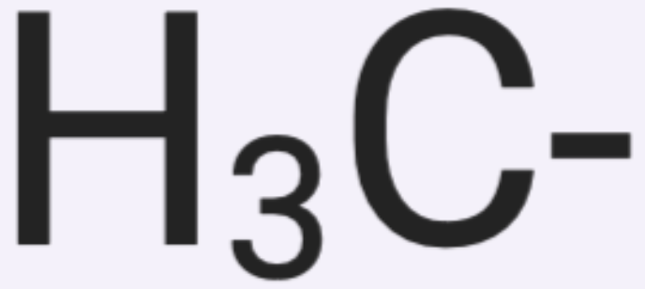

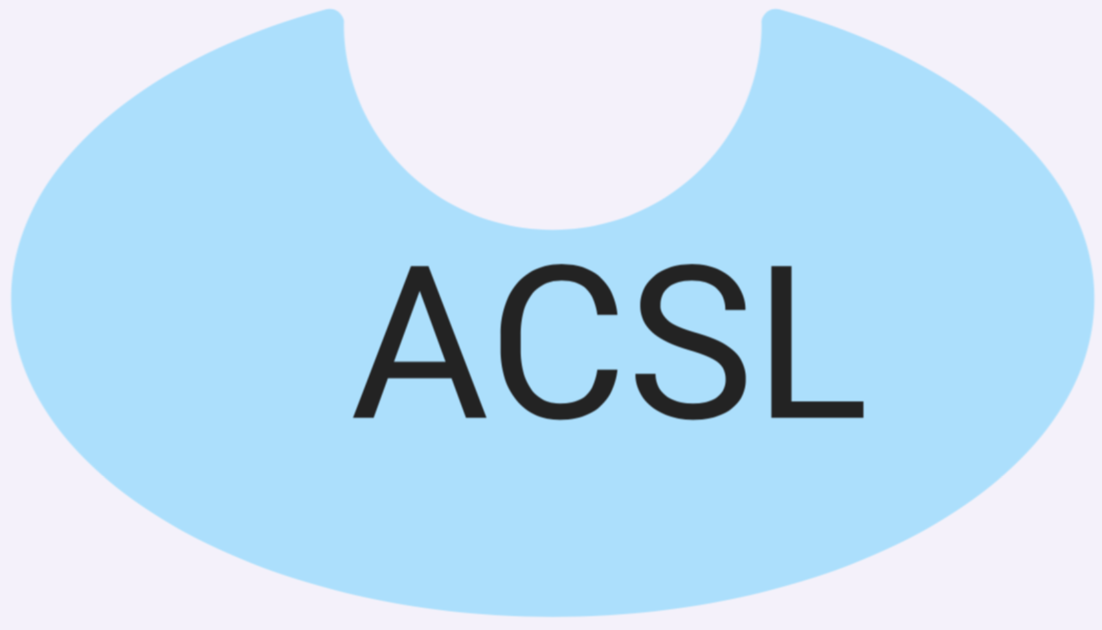



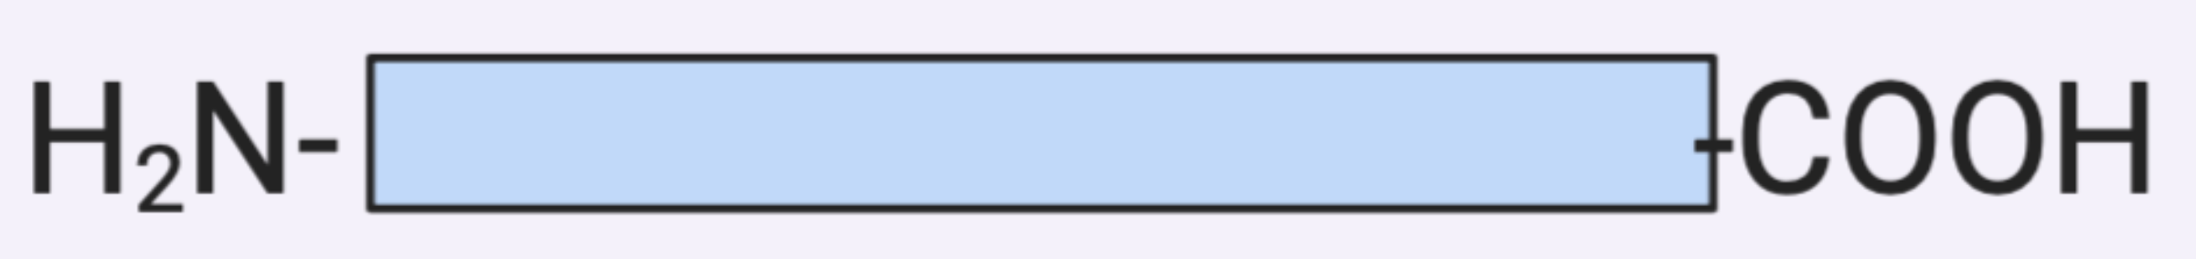
Triacsin C
iNOS Gene
?
iNOS mRNA
iNOS Protein
Triacsin C
Notes:
Since traicsin c inhibit acsl, and triacsin c reduce inos protein expression, so there is likely a relation between them. So we hypothesize

Slide 13
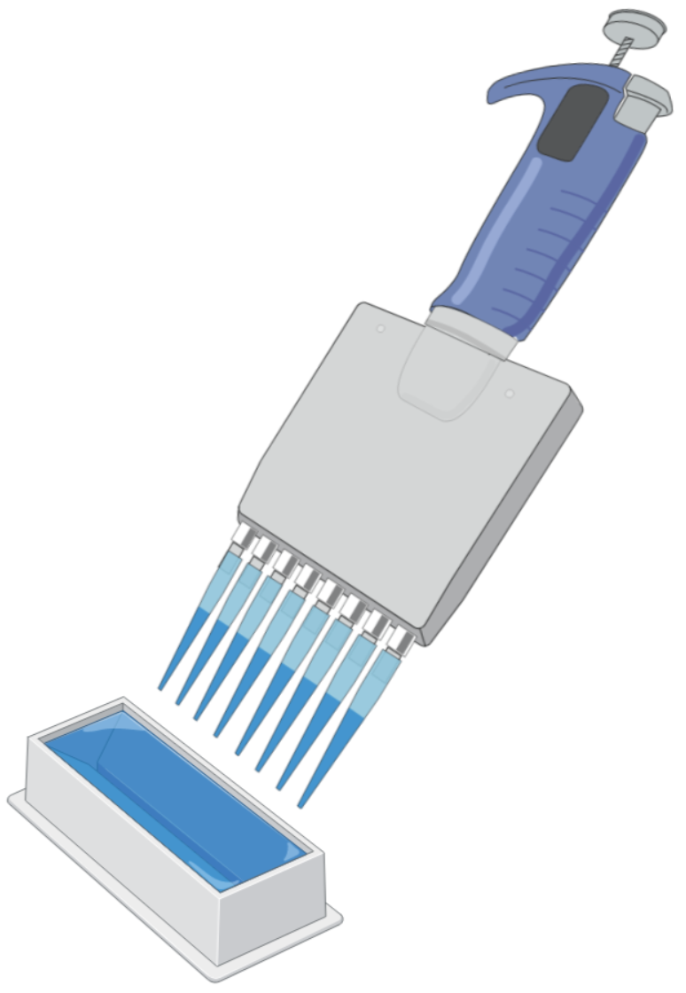
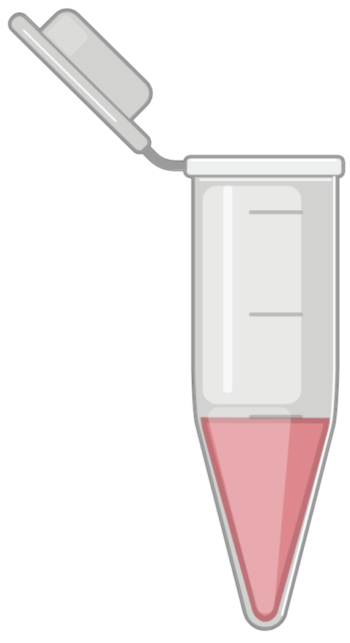
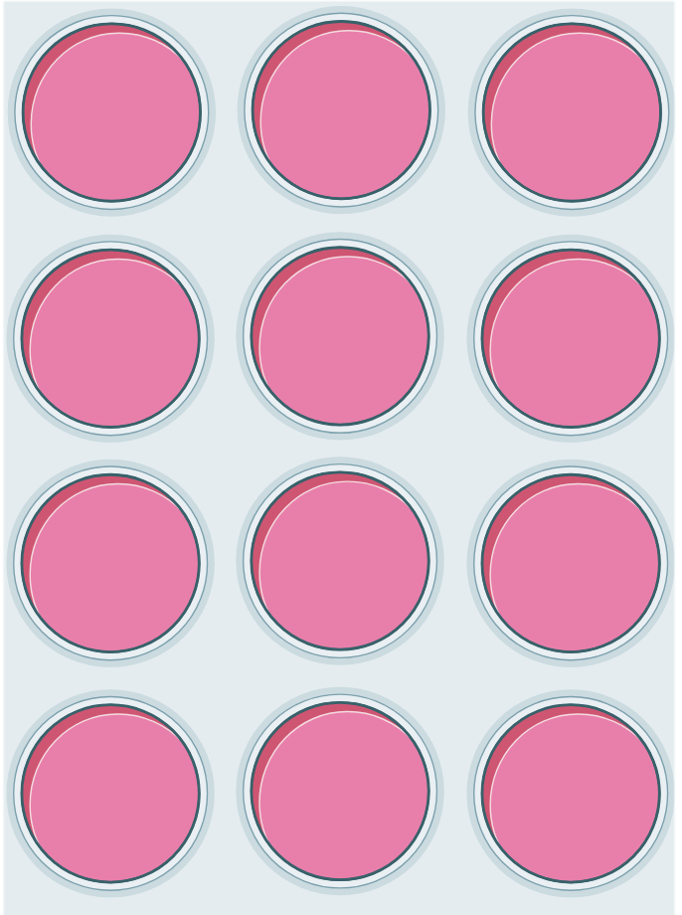
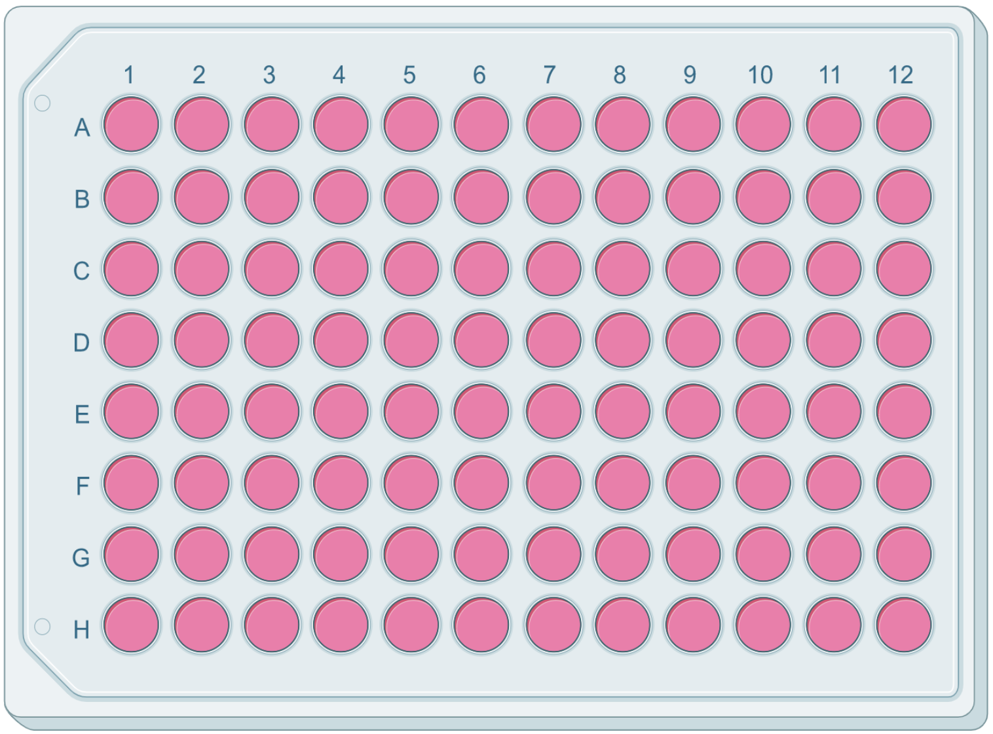
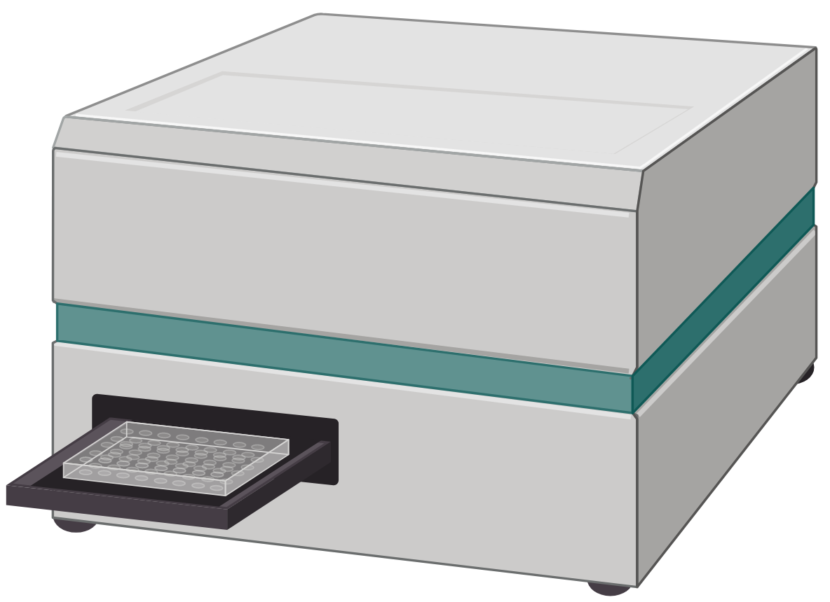
Nitrite Assay
Control
Control + TC
Cytomix
Cytomix + TC
Notes:
Media nitrite assay
We cultured the cells, on confluency, we add triacsic c, 5 um,
At different time point, we collect the media, we did nitrite assay for quantification of nitrite in media.
Fluroscence

Slide 14
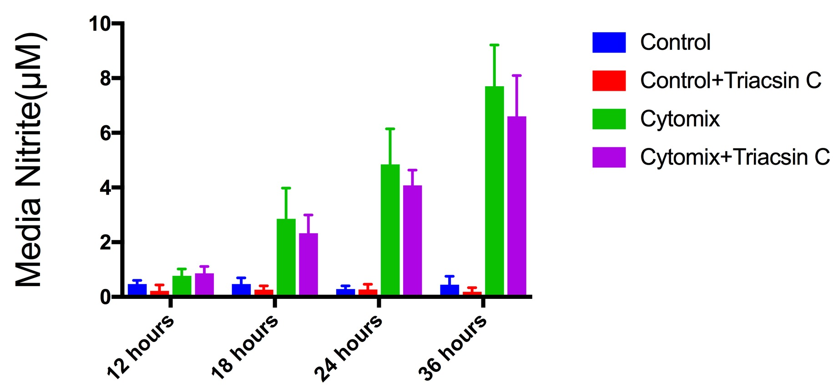
Time Course of Nitrite Accumulation in C6 astrocytoma cells
Notes:
C6 cell were treated with tricasin c for different time point and cultered media were collected. And nitrite is measued. iNOS kick off at 12 hours, and produce more nitric oxide with the time

Slide 15
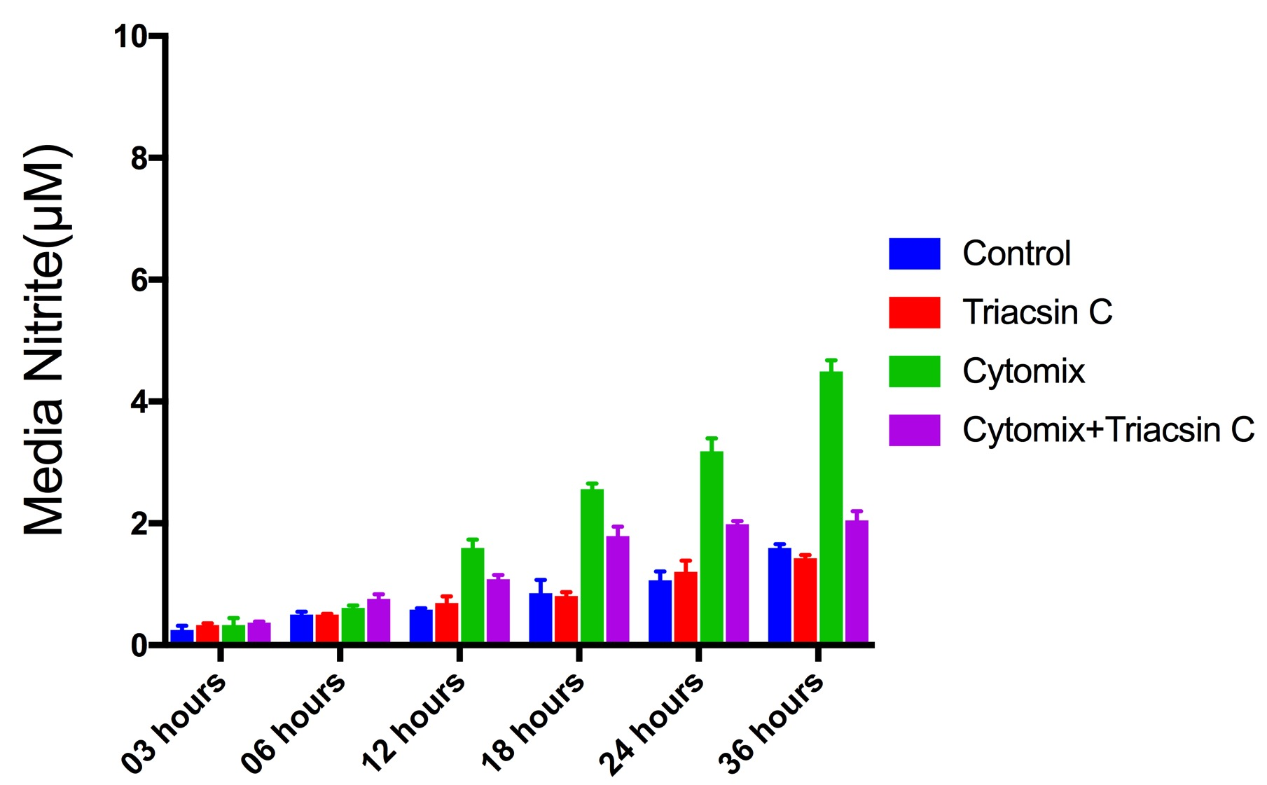
Time Course of Nitrite Accumulation in bEnd.3 cells
Notes:
Same happen to bend3 cells, kicks off 12 hours, and go even 36 hours.

Slide 16
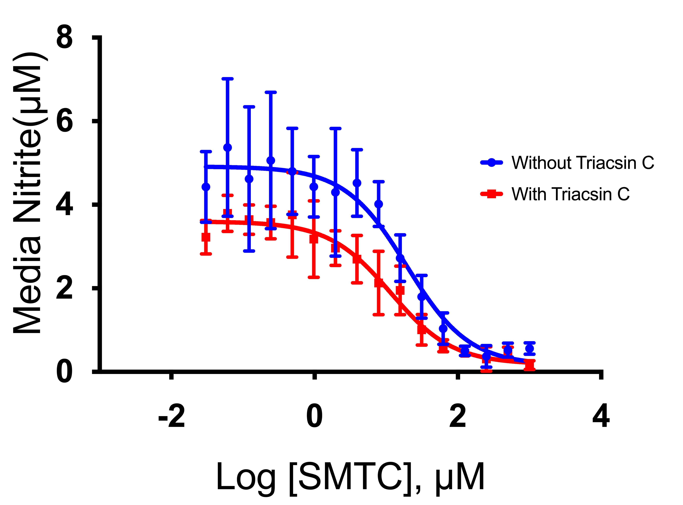
Is the nitrite derived from NOS?
Notes:
While NOS is what we usually think of as the source of media nitrite, there can be other sources. For example, cell death may yield nitrite. To prove that NOS is the source of nitrite, it is necessary to show that NOS inhibition suppresses nitrite accumulation.
We cultured the C6 cell, on confluency, we added cytomix with or without Triacsin C.
We also added L-NAME ( a non selective inhibitor of NOS enzyme) from 7.6 nm to 250 micromolar dose
We measured the media nitrite after 24 hours
This graph suggest that nitrite coming from NOS.

Slide 17
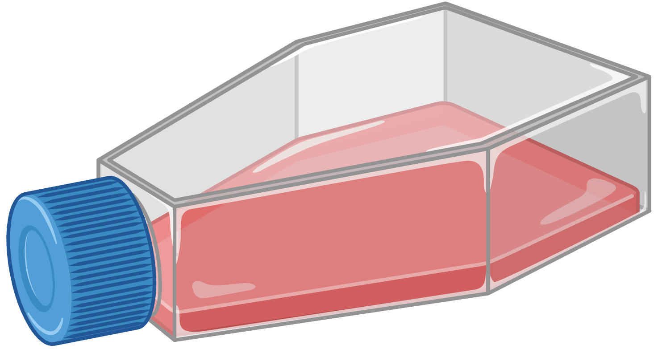


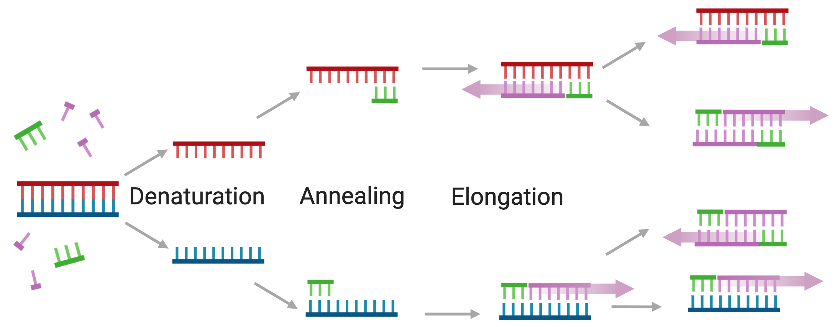
Control
Purified RNA
cDNA
Control + TC
Cytomix
Cytomix +TC
Polymerase Chain Reaction- PCR
Notes:
We did qpcr to see iNOS expression in bend3 and c6 cells. Also did qpcr for nNOS and enos
https://ampliqon.com/en/products/pcr-enzymes/real-time-pcr/realq-plus-master-mix-green/
For graph image

Slide 18
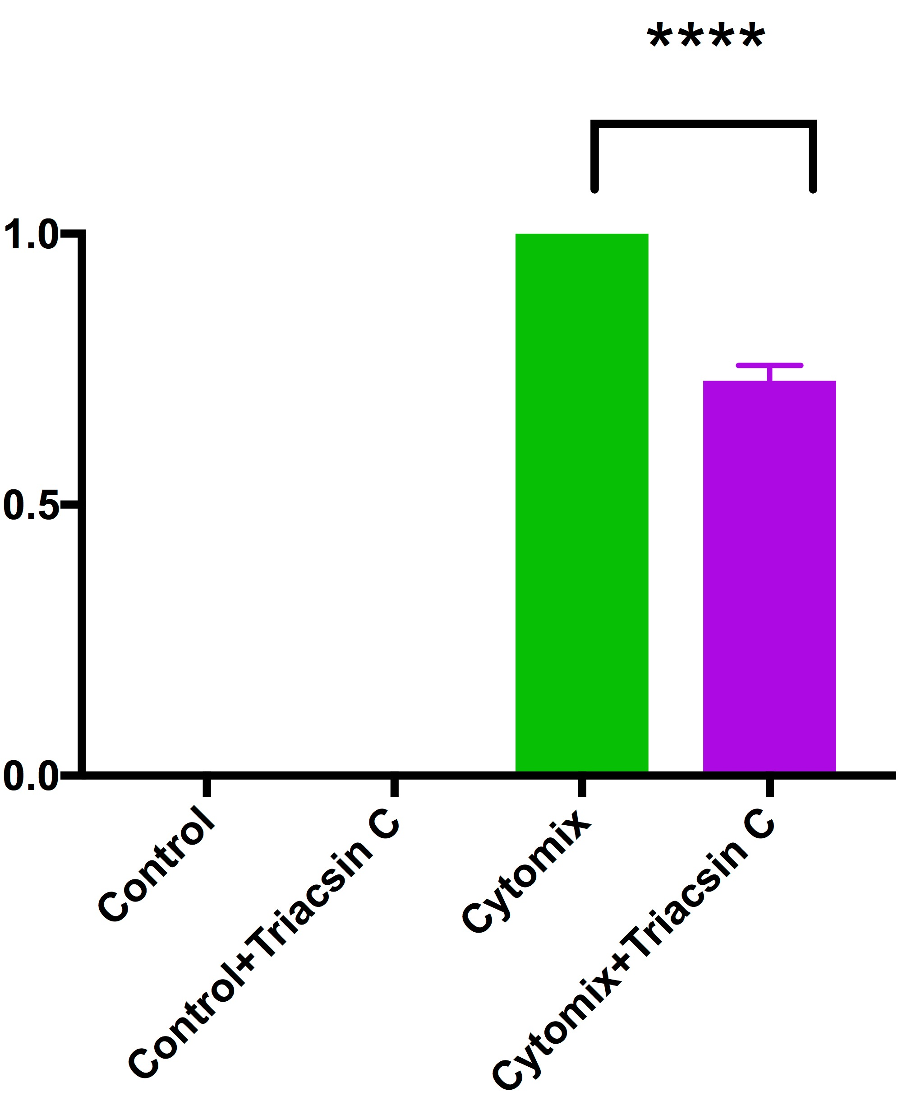
iNOS Gene Expression in C6 Astrocytoma Cell
Notes:
We cultured the C6 cell, on confluency, we added cytomix with or without Triacsin C. for 24 hours
Then we did qpcr , to see the gene expression
As you can see form plot TC reduce iNOS expression in c6 cells

Slide 19
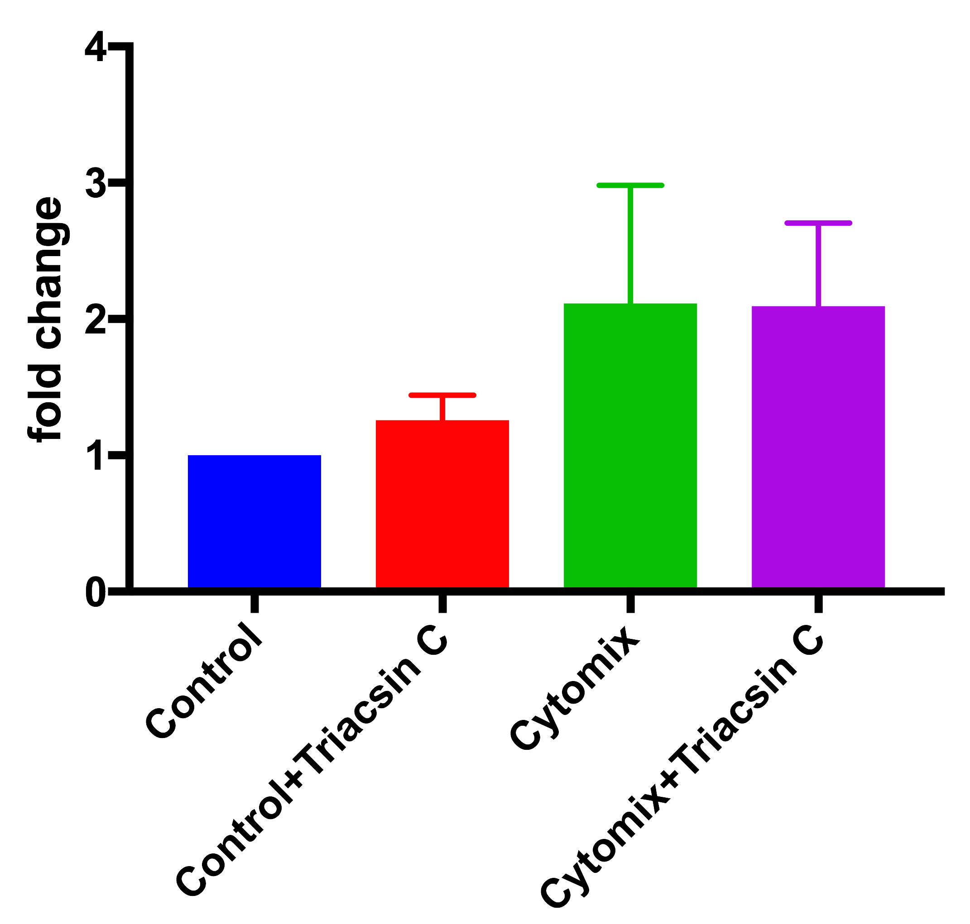
nNOS Gene Expression in C6 Astrocytoma Cell
Notes:
We also wanted to see whether cytomix change nNOS expression. Cytomix does not change nNOS expression and TC does not do anything when used with cytomix

Slide 20
Nitrite Accumulation in C6 Astrocytoma Cell
Notes:
We aslo collected the media from cultured flask and mesured media nitrite , this also conform our previous results. It suggest that NO coming from iNOS induction and TC can reduce the amount of NO production.

Slide 21
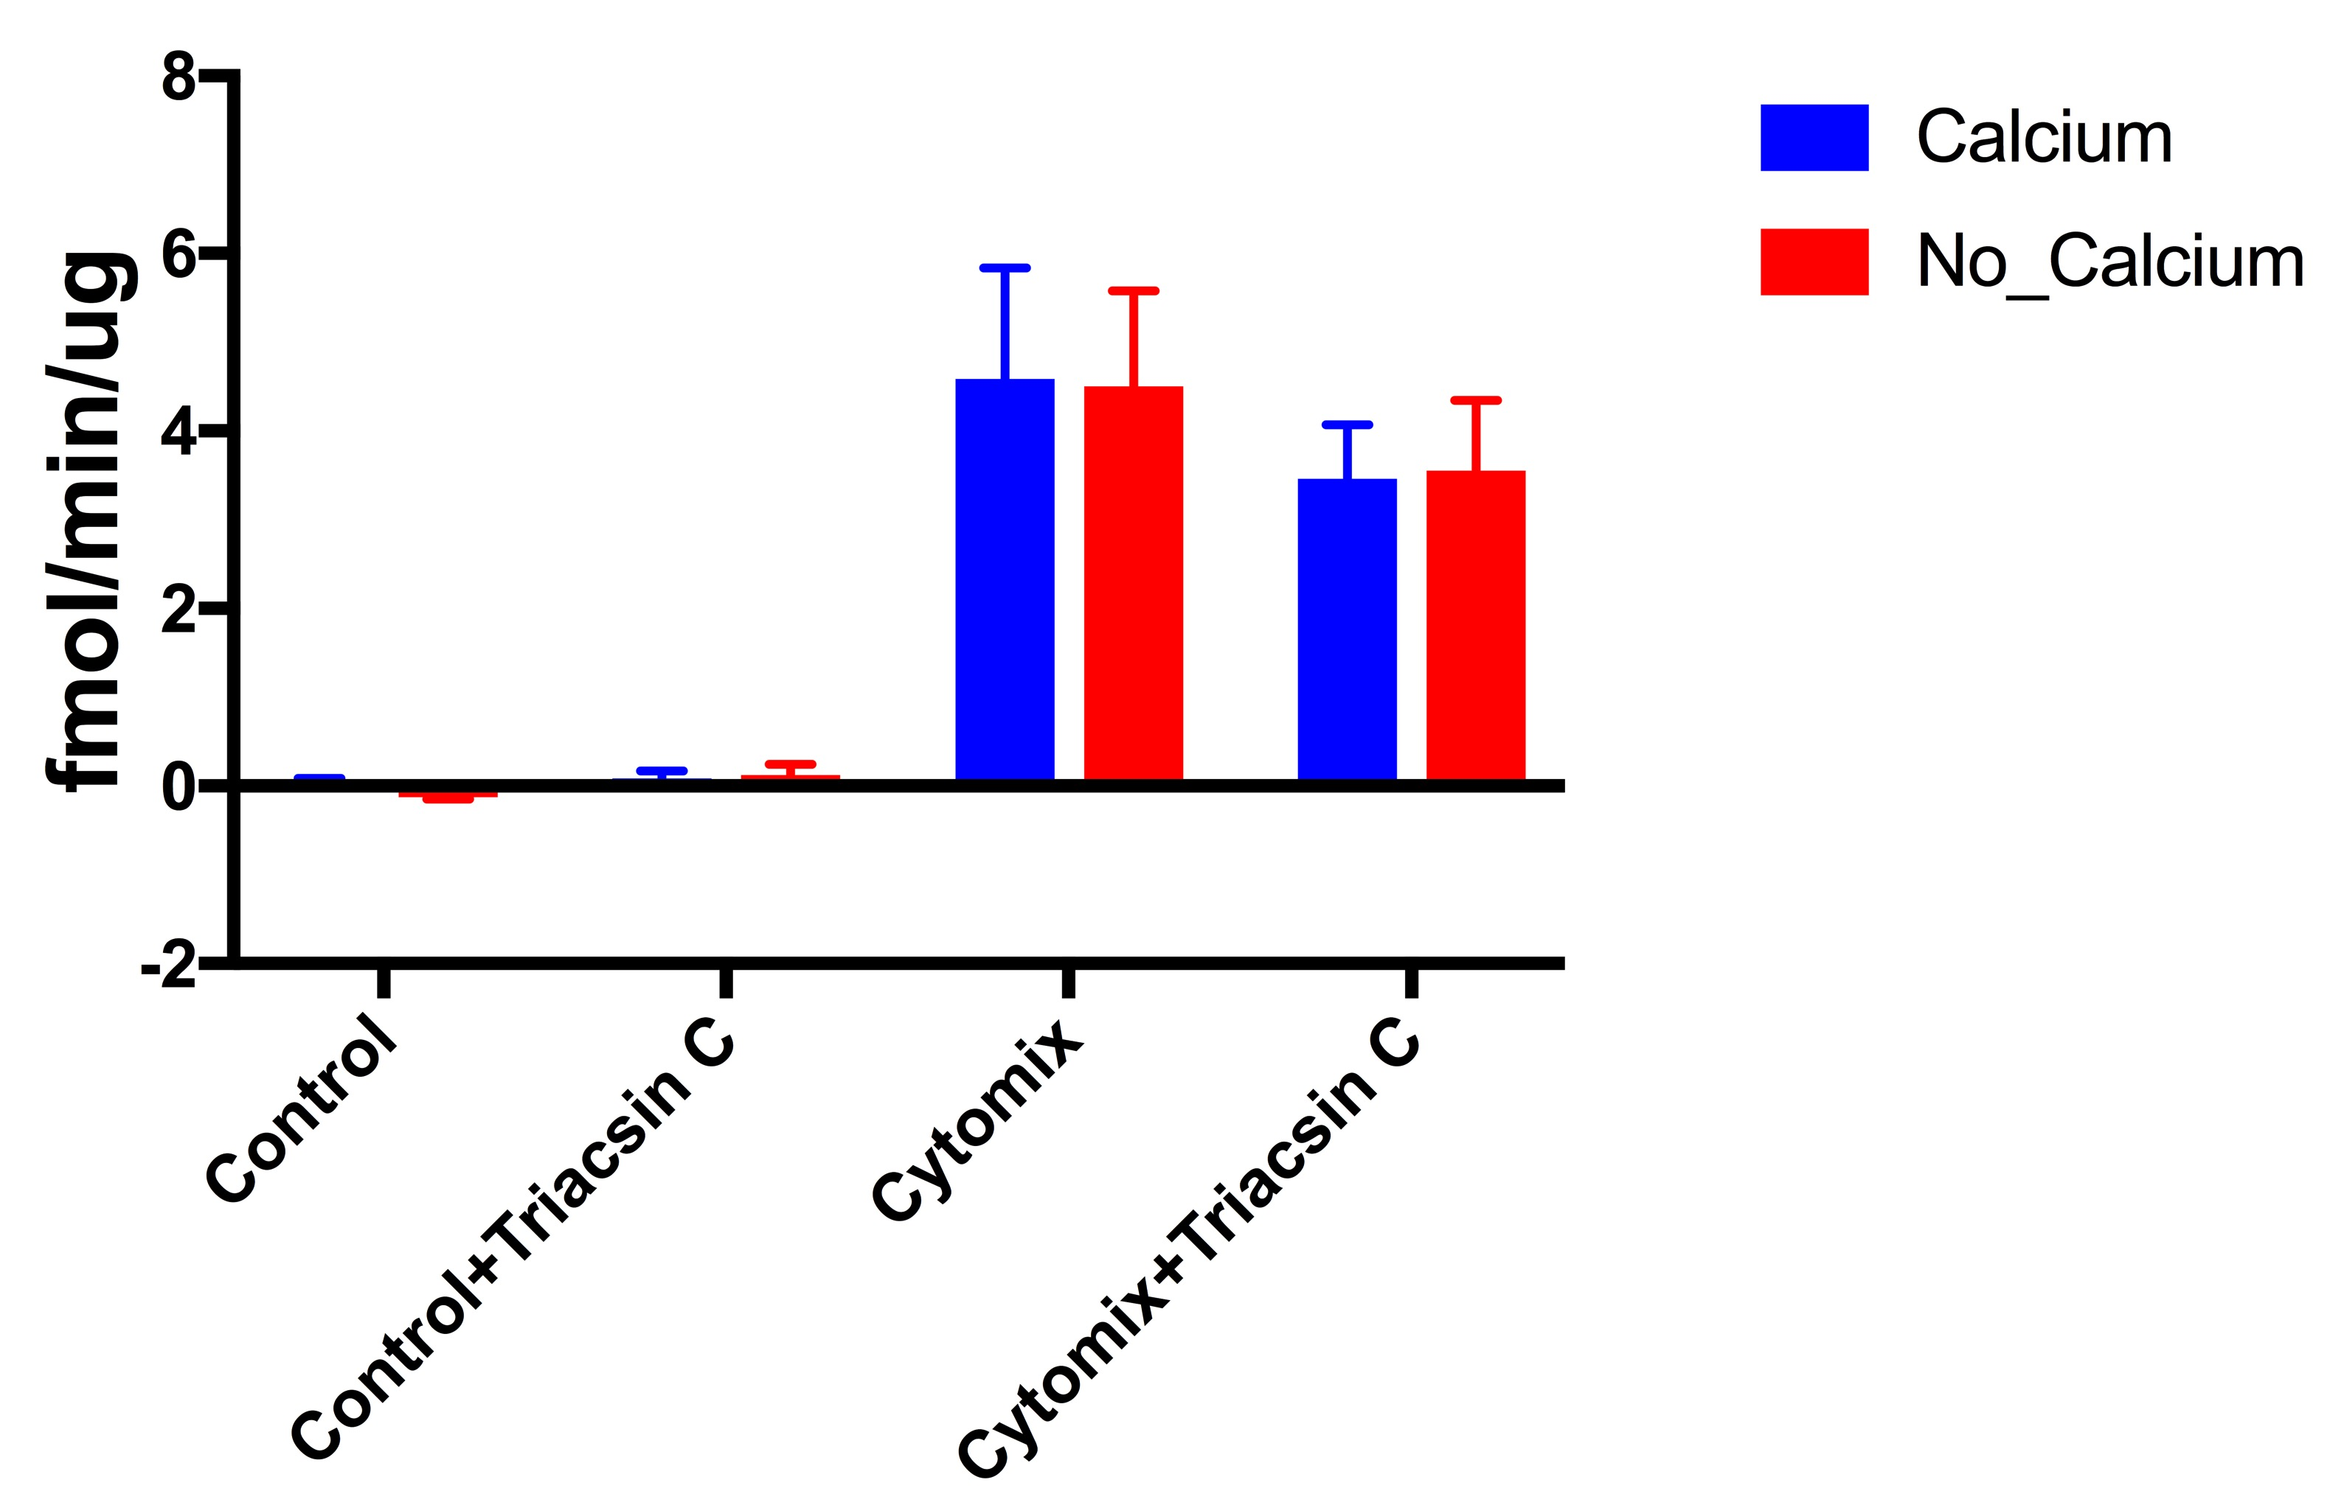
NOS Catalytic Activity in C6 Astrocytoma Cell
Notes:
We also measure catalytic activity of NOS, with presence or absence of calcium.
In both cases, cytomix upregualate iNOS expession and TC inhibit the the catalytic activity.
(cytomix) - There is no difference in with calcium and without calcium, means the activity is likely from iNOS.

Slide 22
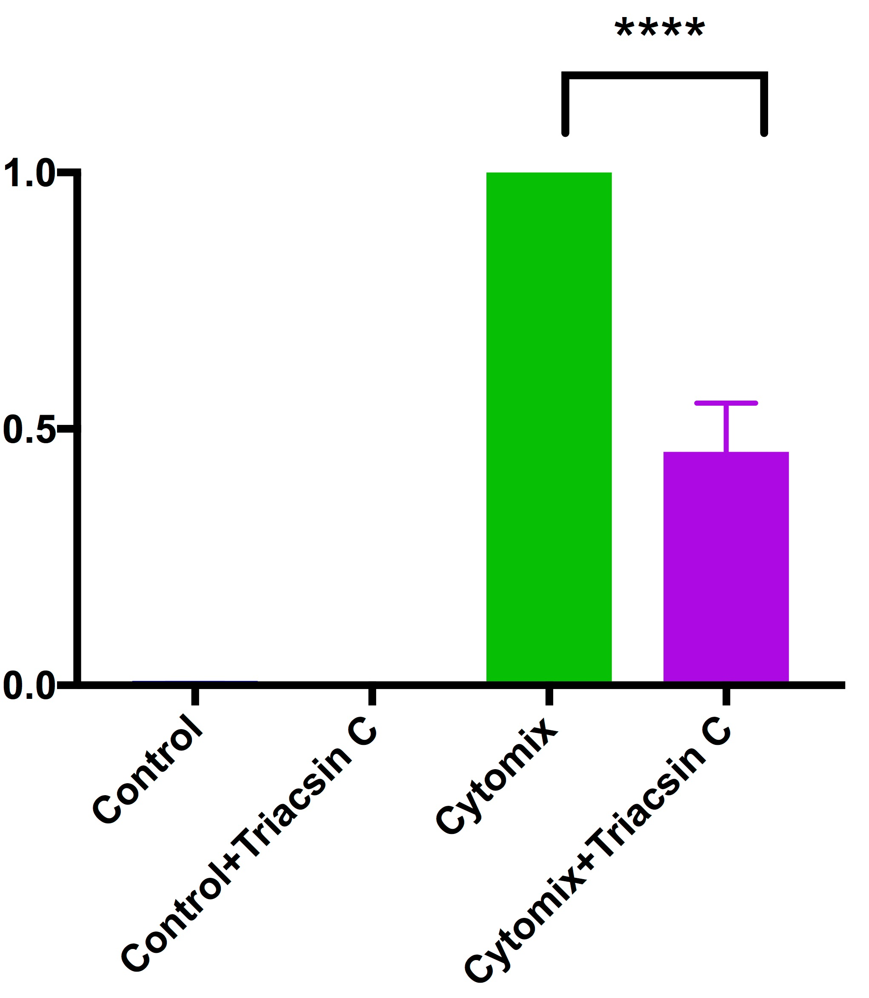
iNOS Gene Expression in bEnd.3 Cell
Notes:
N = 3
For further confirmation, we try qpcr in different cells, bend3 cell,
TC also inhibit iNOS expression in bend3 cells

Slide 23
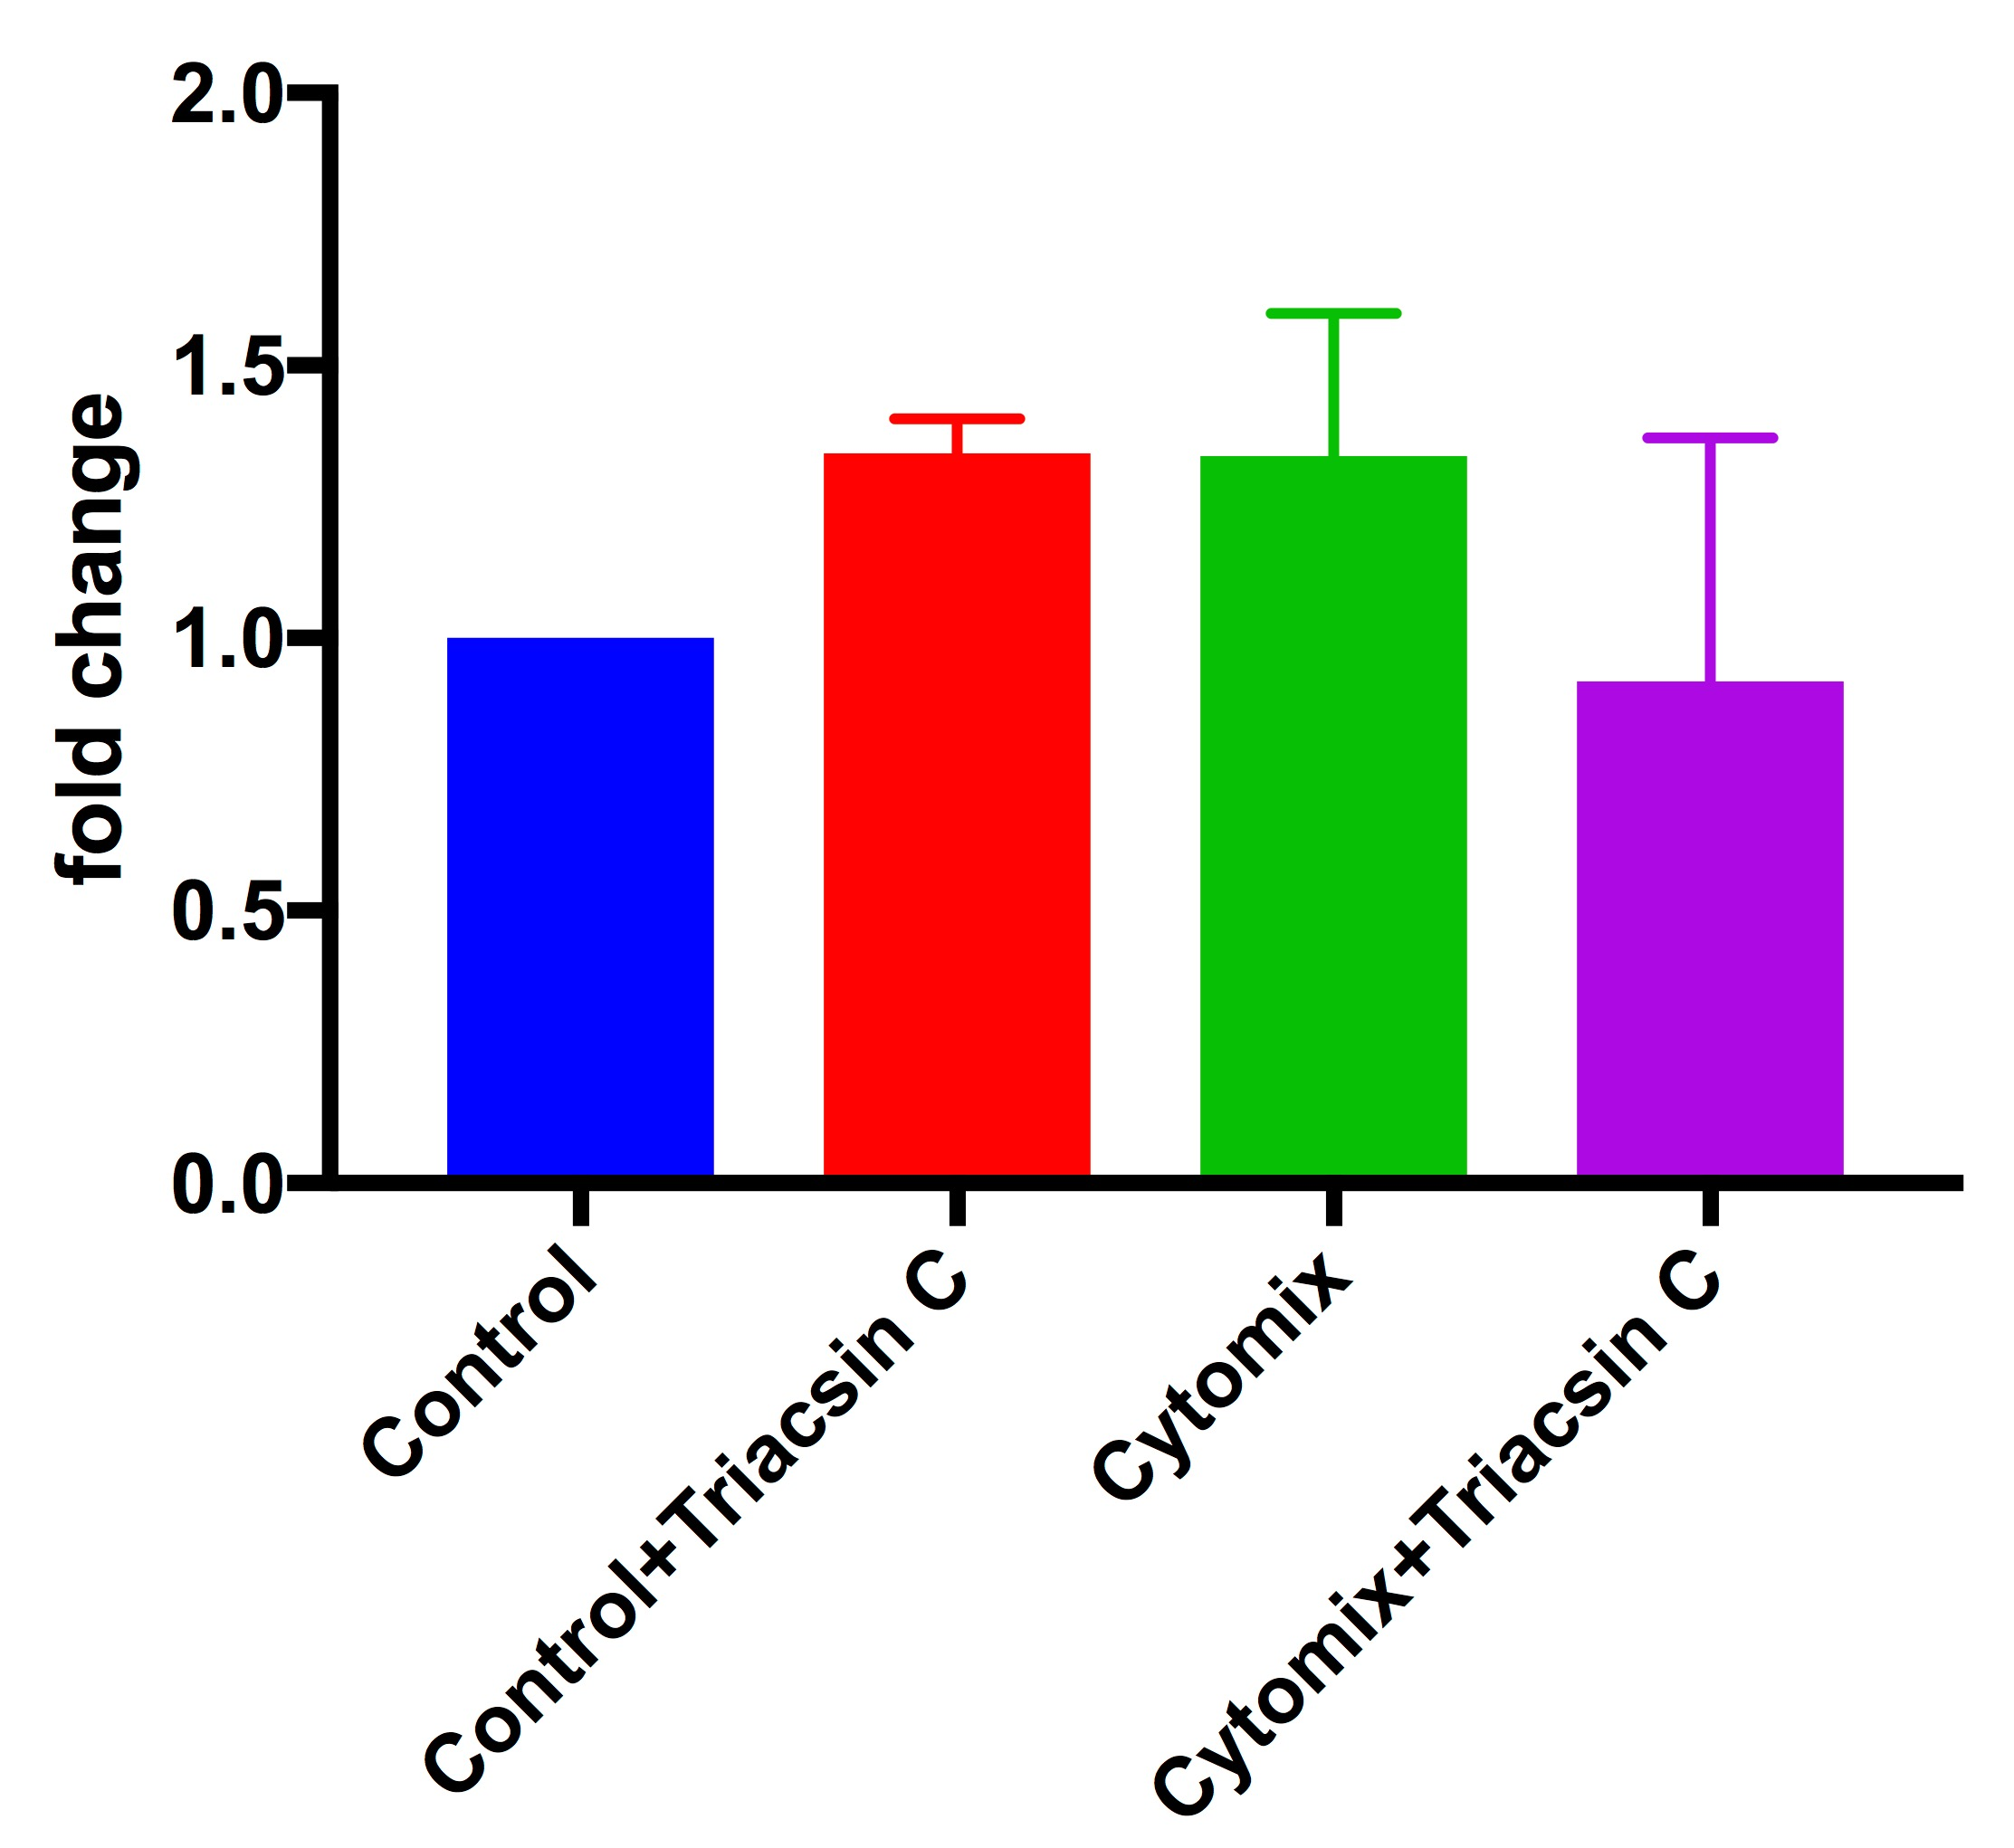
eNOS Gene Expression in bEnd.3 Cell
Notes:
We also did qpcr for eNOS , cytomix does not change eNOS expression with or without TC.

Slide 24
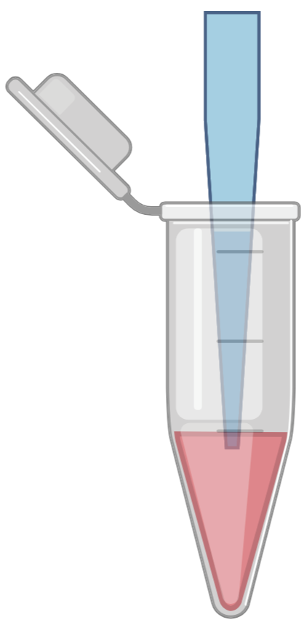
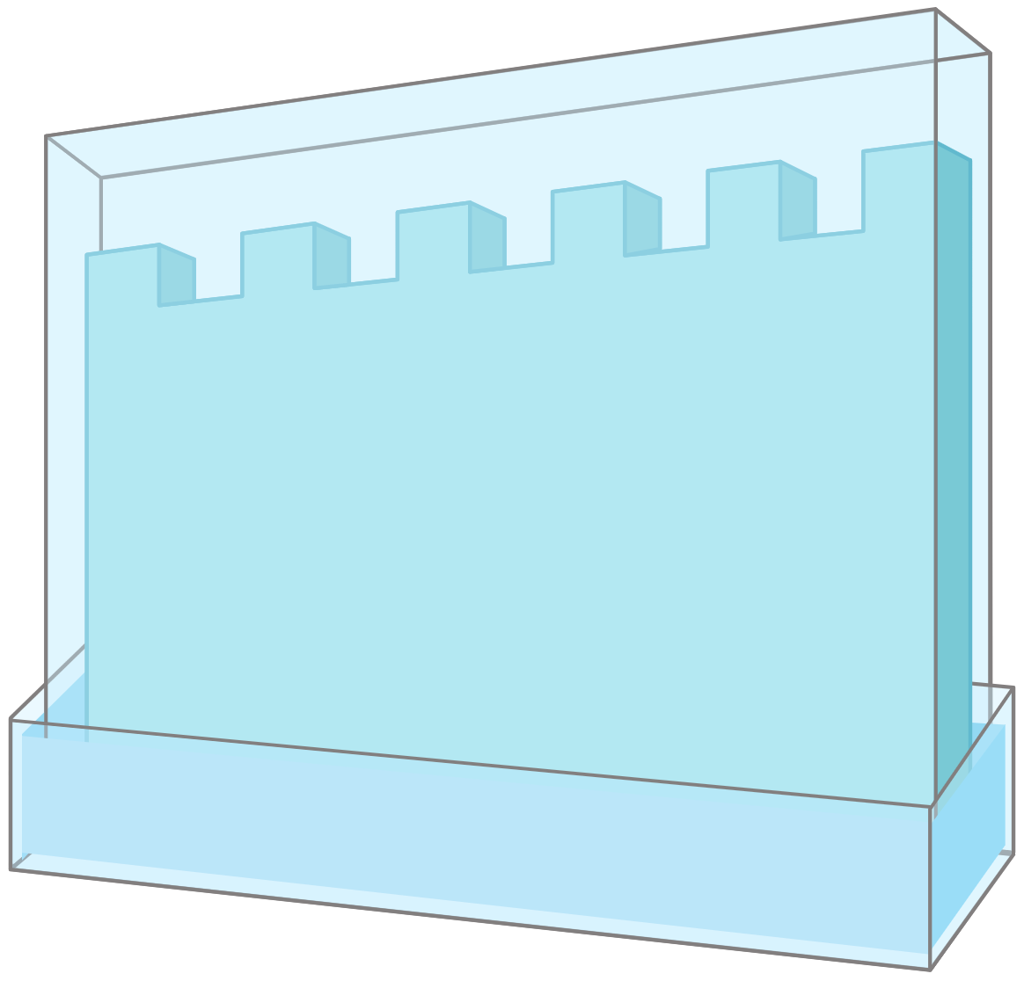
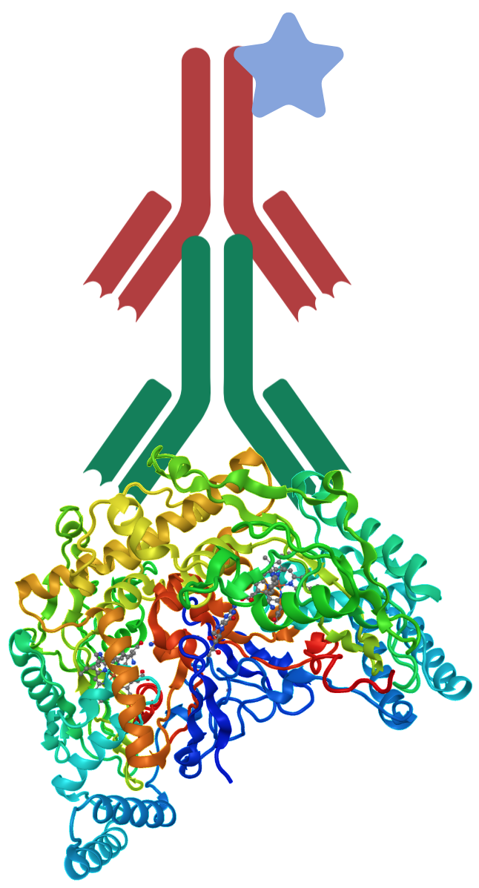
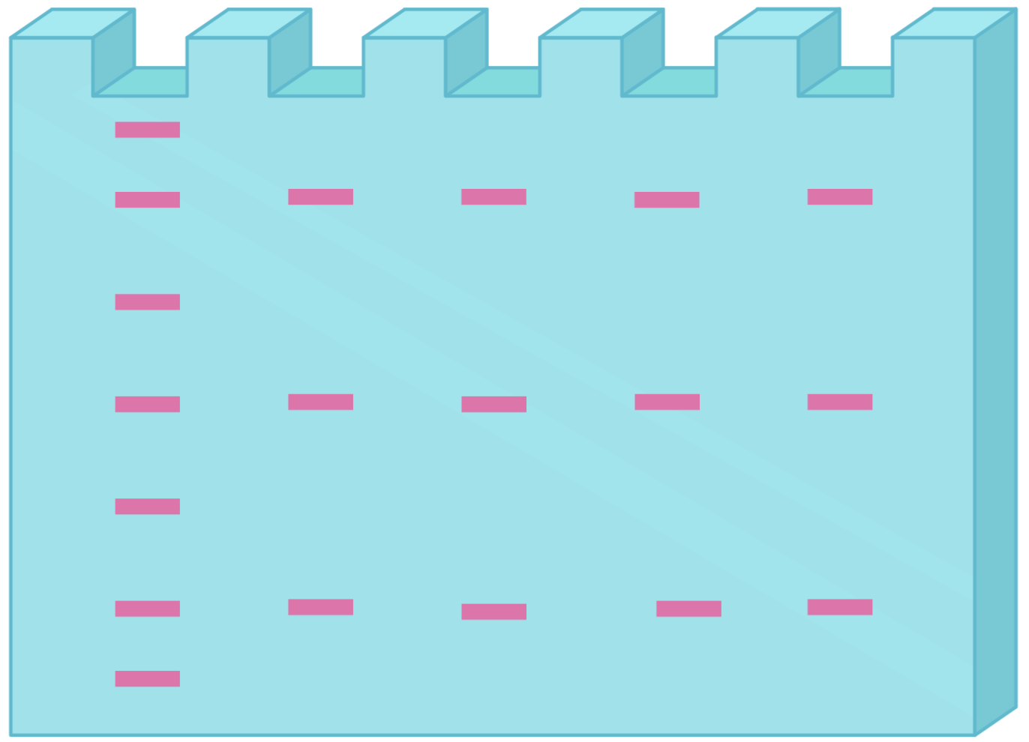

Gel Electrophoresis
Control
Protein
2⁰ Antibody
Control + TC
Gel
to
Membrane
1⁰ Antibody
Cytomix
Cytomix +TC
Protein
Notes:
We also did western blot for iNOS protein expression. We keep this 4 group. After 24 hours, we took the protein , measured it, loaded into 4-20 % gel,
Transferred to pvdf membrane. Then probed for protein of interest.

Slide 25
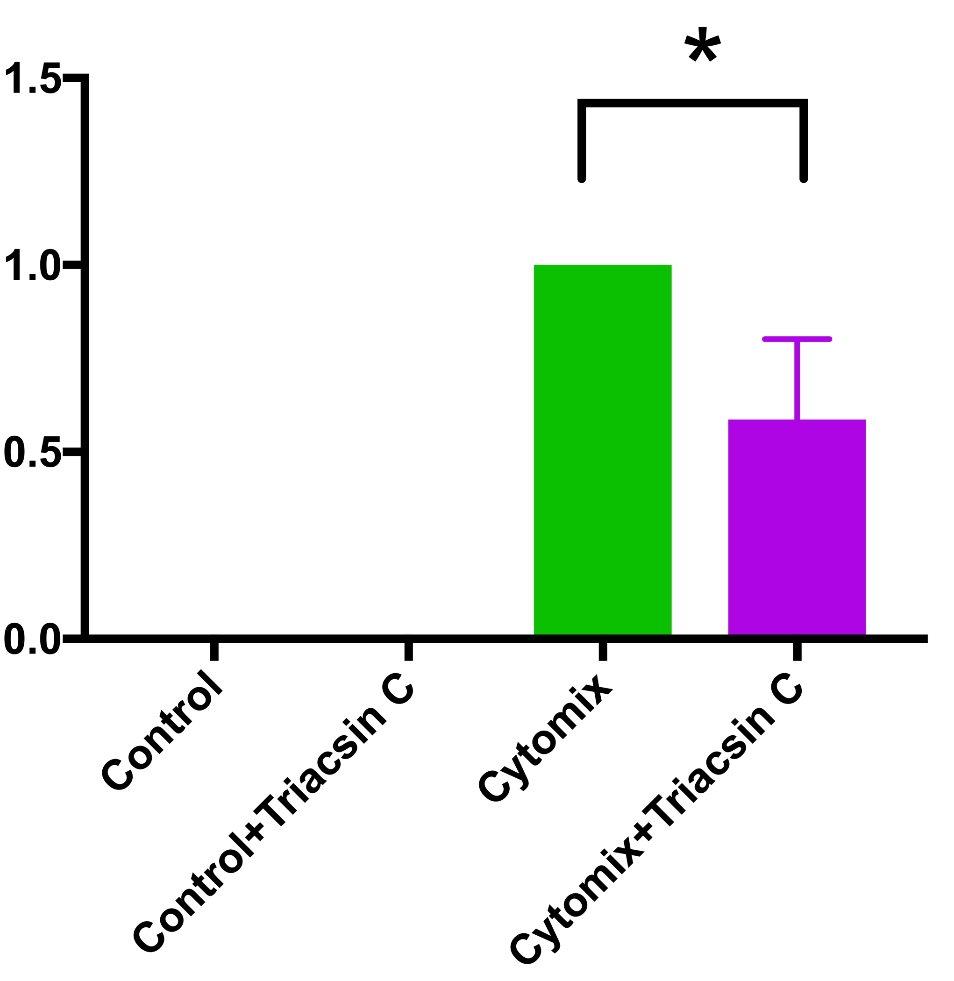
iNOS Expression in bEnd.3 Cell
iNOS
⍺-Actin
Control
Cytomix
Control + TC
Cytomix + TC
Notes:
Also confirm by measuring protein level of iNOS in bend3 cells.

Slide 26
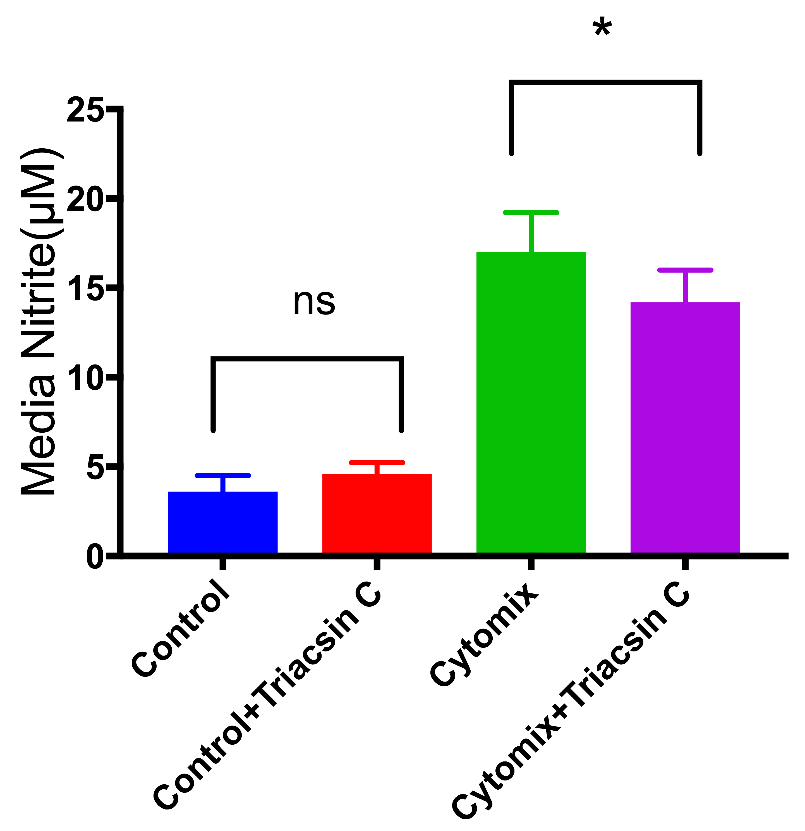
Nitrite Accumulation in bEnd.3 Cell
Notes:
Pcr + wb media, 5 sample
Measured nitrite from media, TC reduces the production of NO.

Slide 27
Summary
Triacsin C inhibits cytokine stimulated iNOS upregulation in C6 astrocytoma cells and bEnd.3 cells
Triacsin C reduce cytokine stimulated nitrite accumulation in C6 astrocytoma and bEnd.3 cells.
Triacsin C does not change nNOS expression in C6 astrocytoma cells.
Triacsin C does not change eNOS expression in bEnd.3 cells.

Slide 28
Conclusion
iNOS Expression Requires Long Chain Fatty Acyl CoA Synthetase (ACSL)
Notes:
So our next question is how acsl regulate/ play role in iNOS expression.

Slide 29
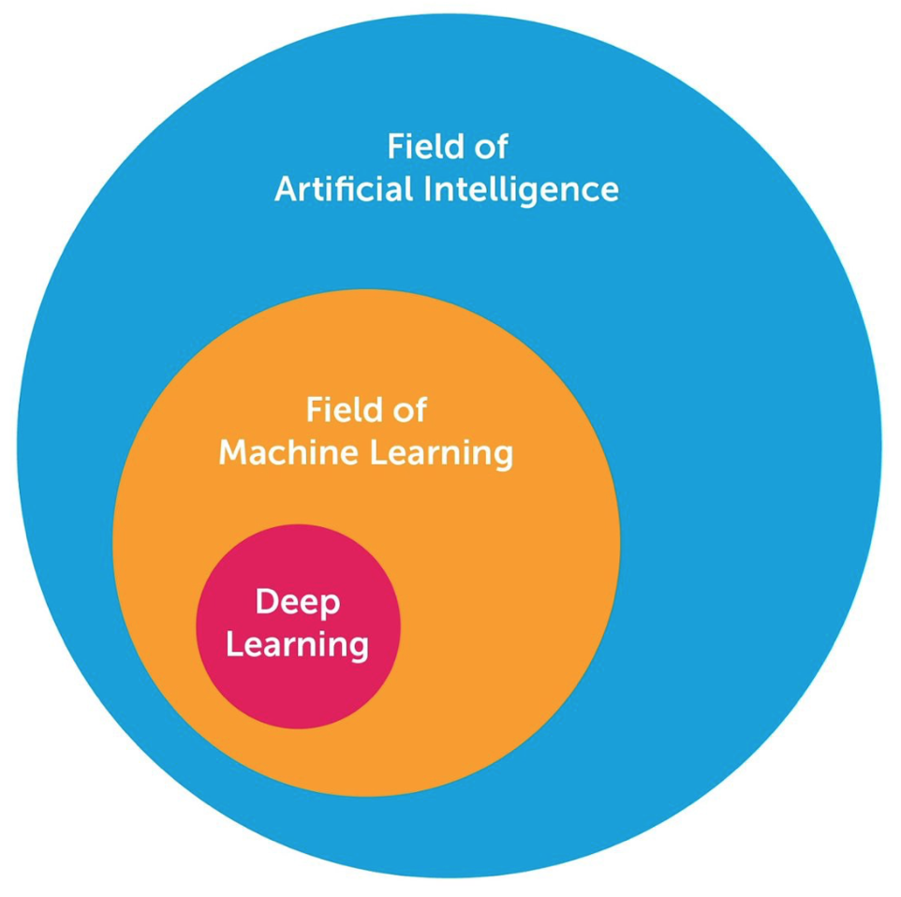
Deep Learning
Deep learning is a class of machine learning algorithms that uses multiple layers to progressively extract higher level features from the raw input.
https://en.wikipedia.org/wiki/Deep_learning
https://medium.com/cracking-the-data-science-interview/the-10-deep-learning-methods-ai-practitioners-need-to-apply-885259f402c1

Slide 30
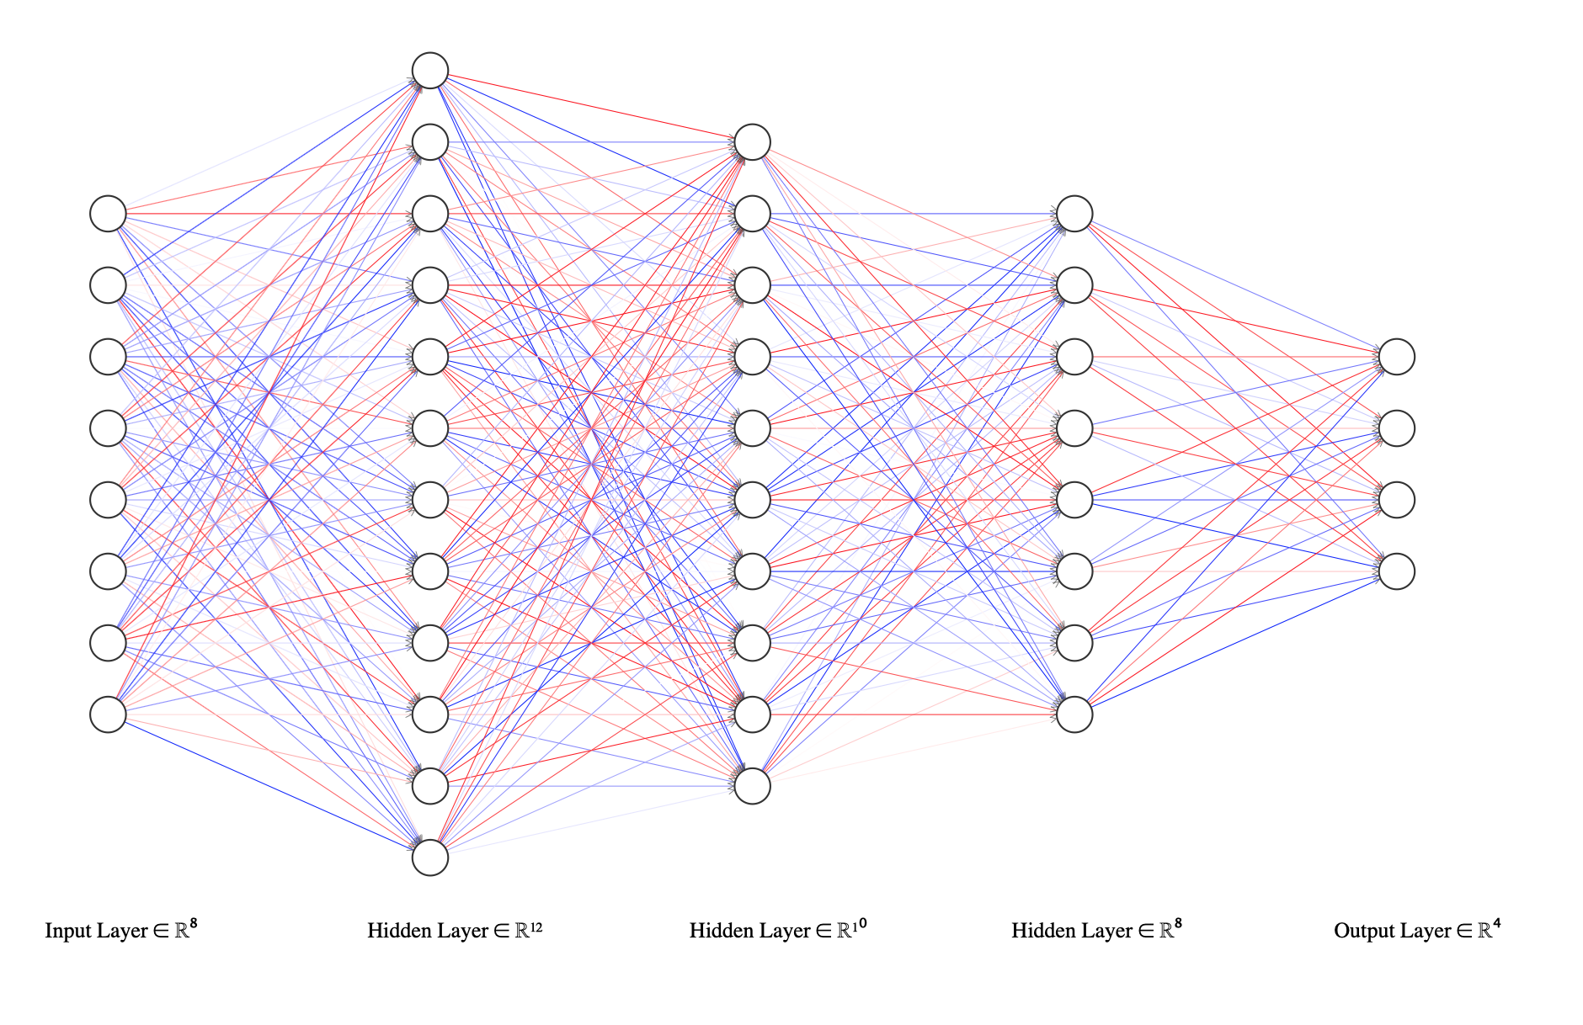
Structure of Neural Networks
a | b | c | d | e | f | h | i | target
 |  |  |  |  |  |  |  | 1
 |  |  |  |  |  |  |  | 2
 |  |  |  |  |  |  |  | 3
 |  |  |  |  |  |  |  | 4
 |  |  |  |  |  |  |  | 1
 |  |  |  |  |  |  |  | 3
http://alexlenail.me

Slide 31
Feed Forward Networks

Slide 32
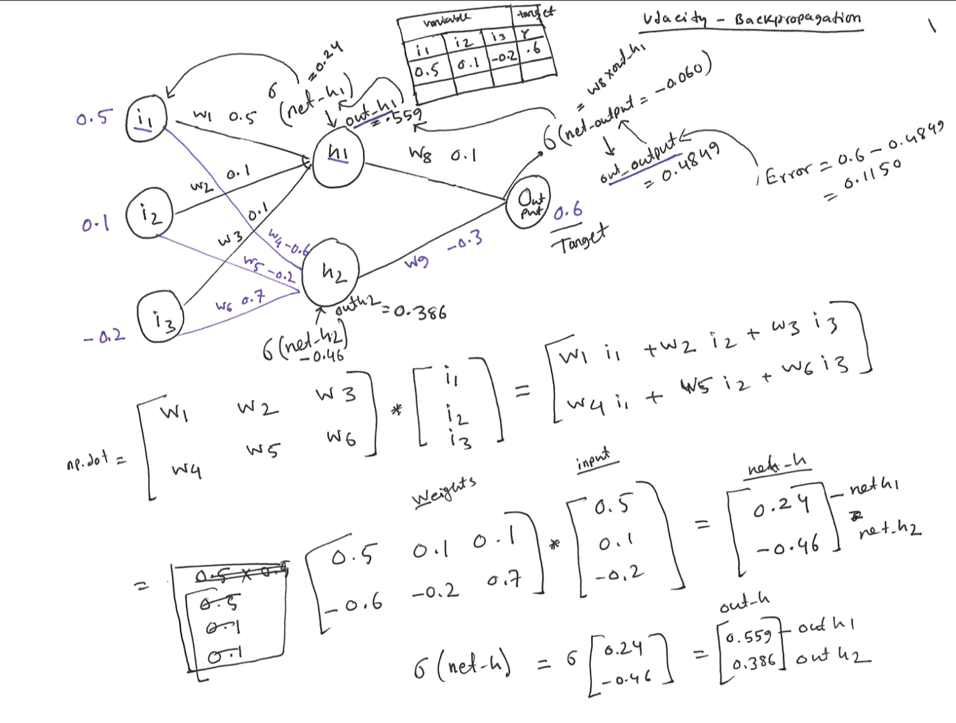
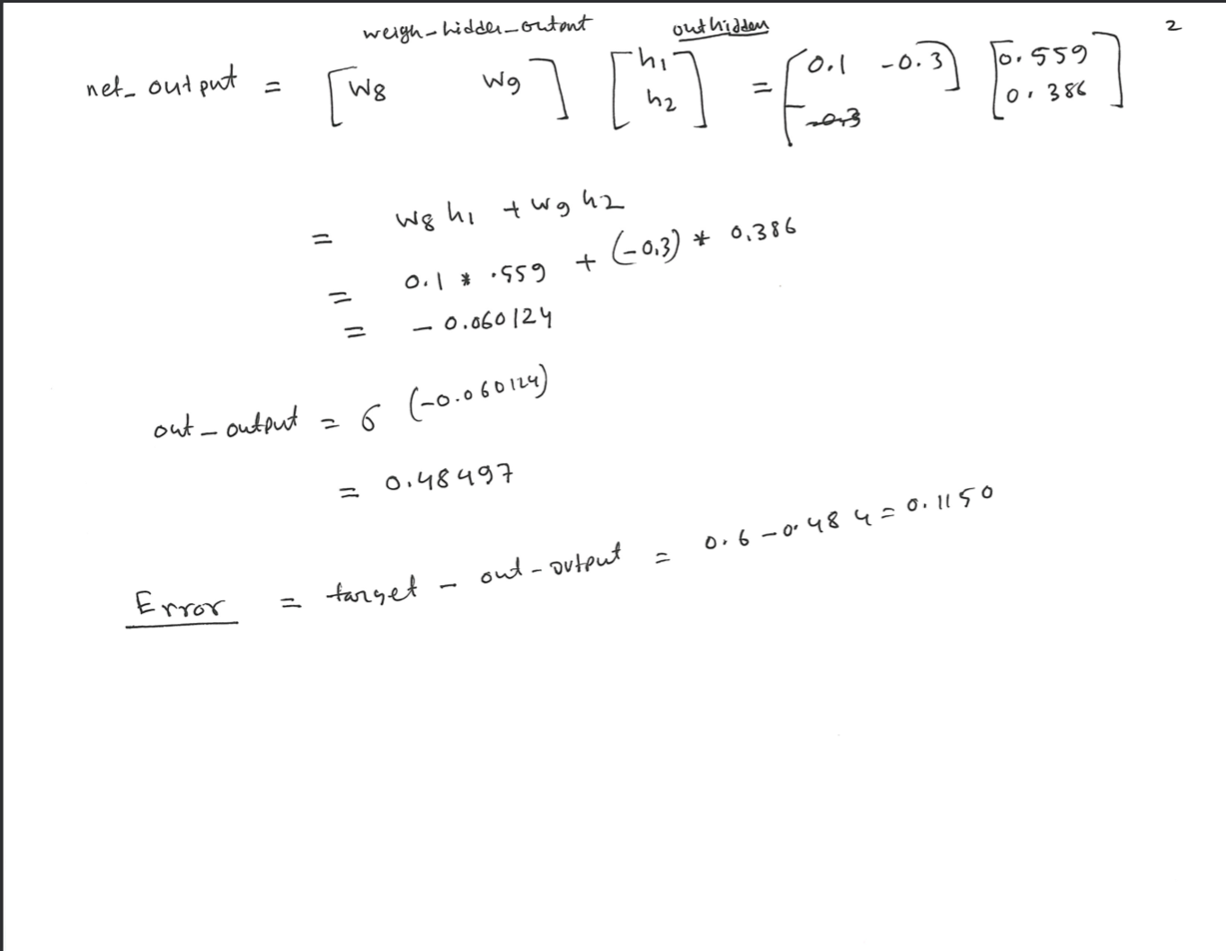

Slide 33
Backpropagation

Slide 34
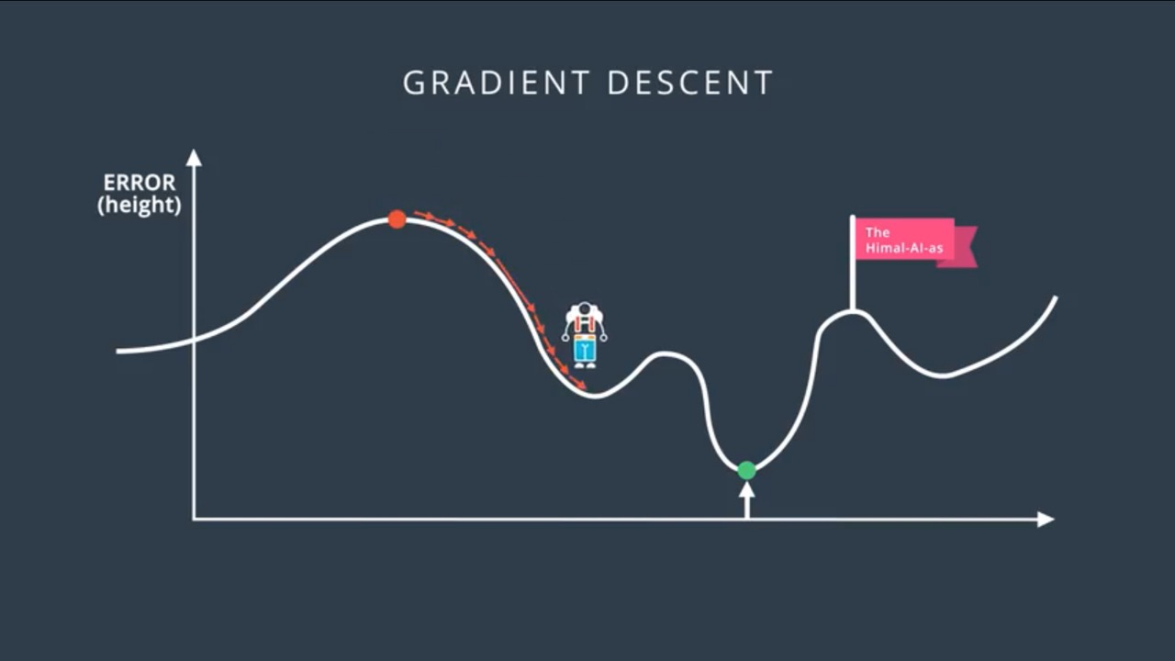
Backpropagation

Slide 35
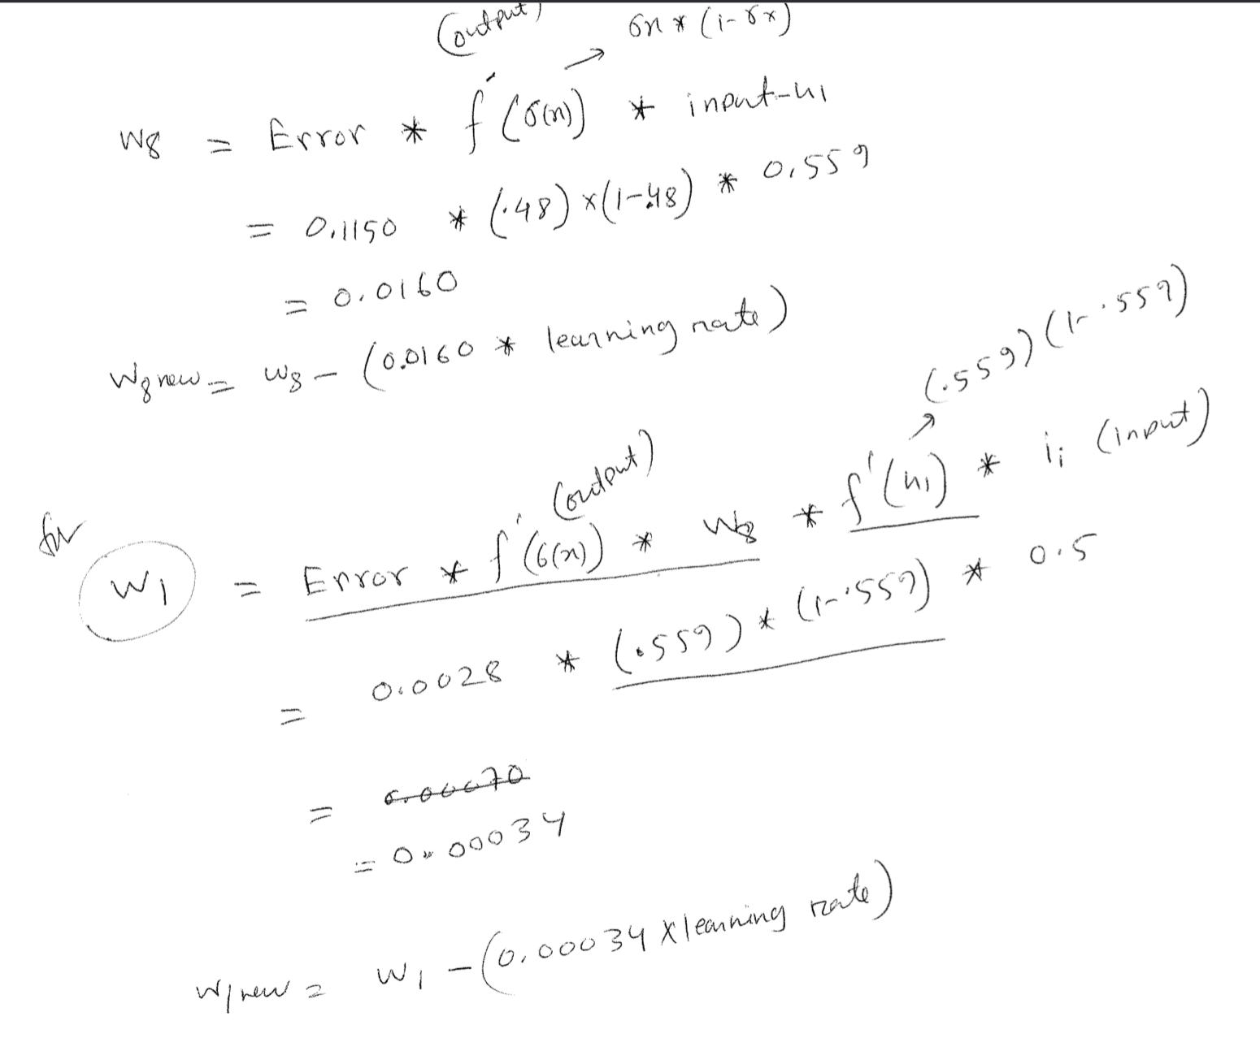

Slide 36
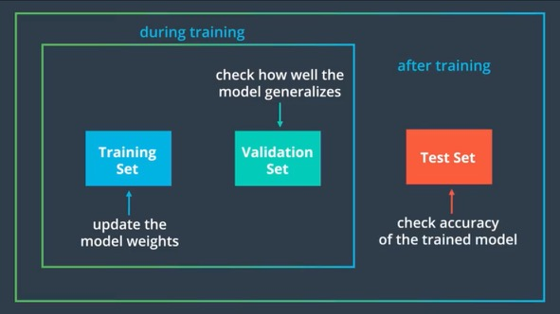
Dataset

Slide 37
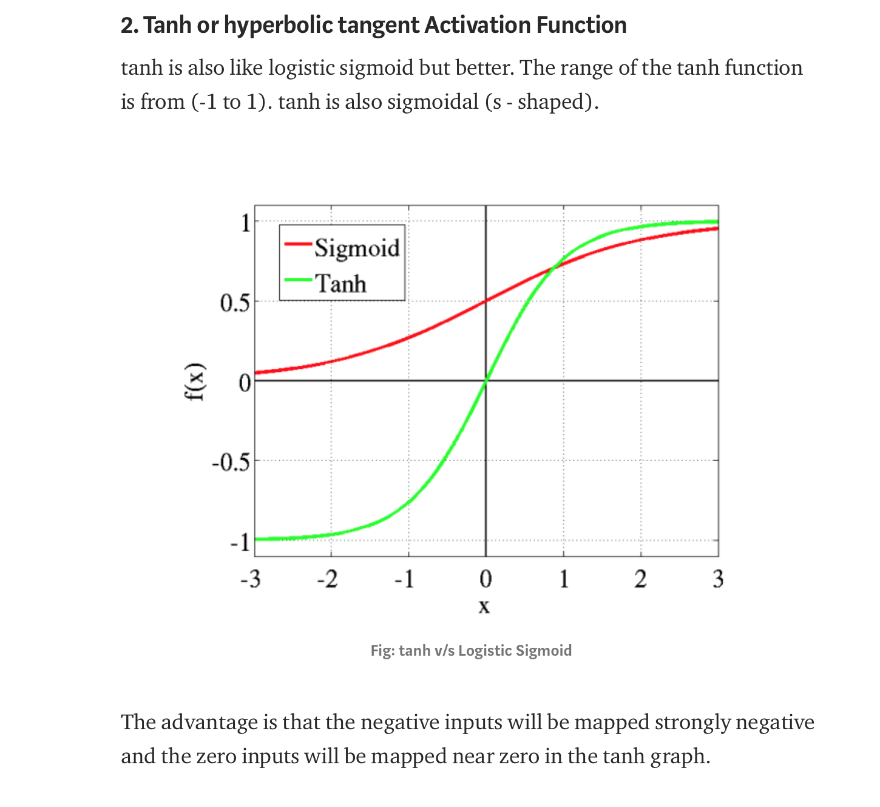
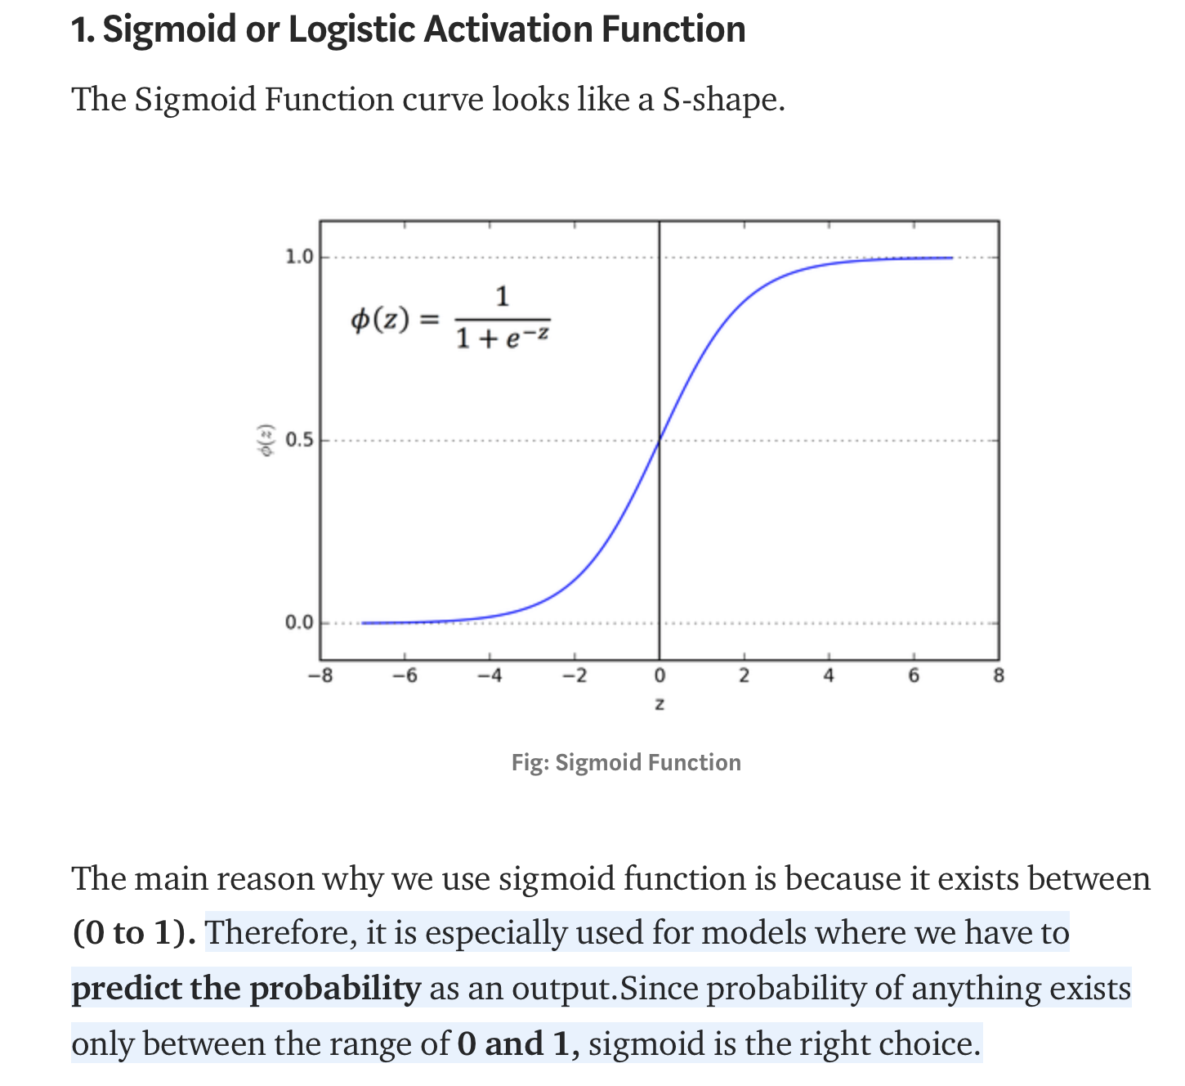
Activation Function
https://towardsdatascience.com/activation-functions-neural-networks-1cbd9f8d91d6

Slide 38
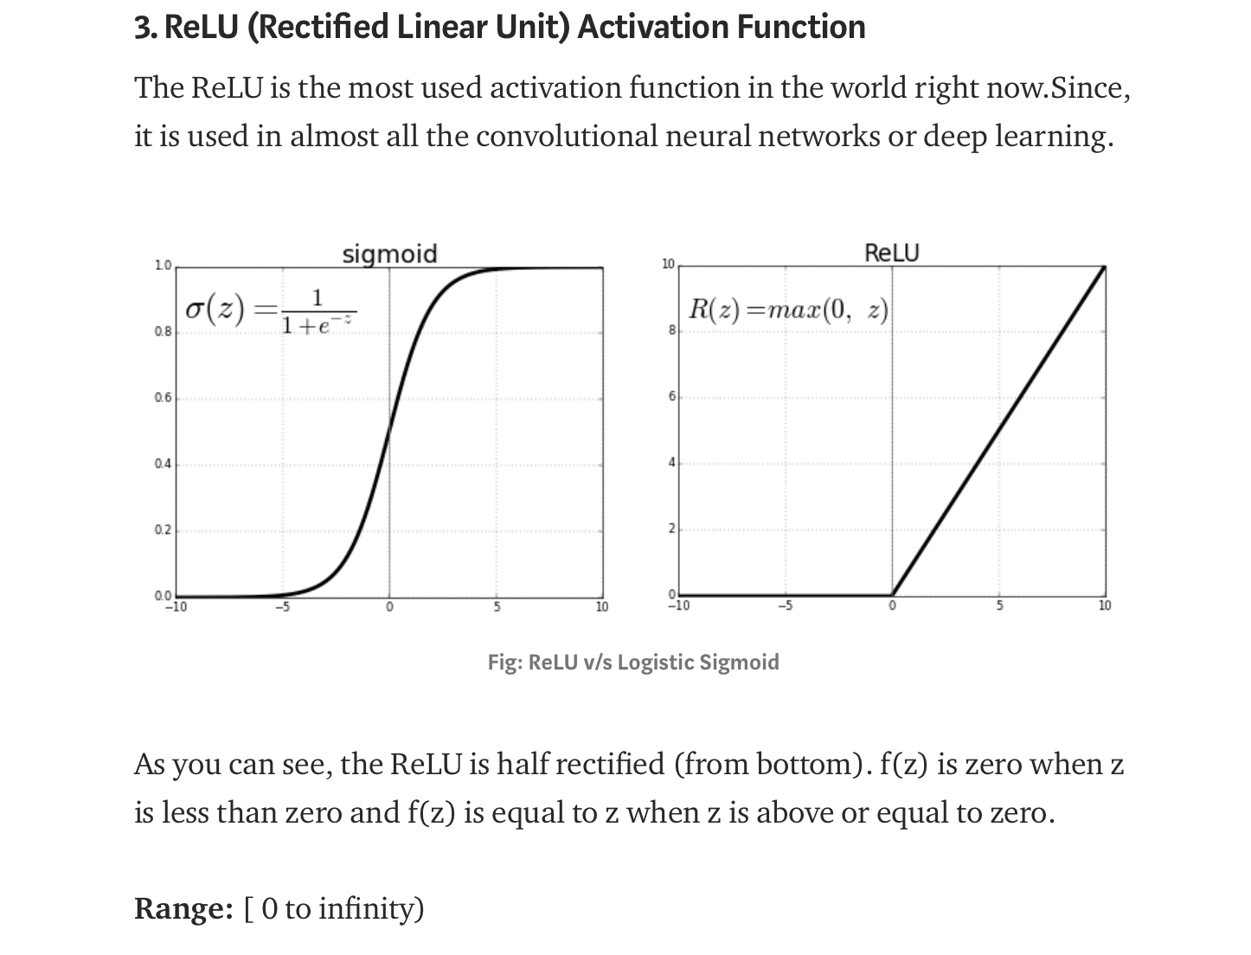
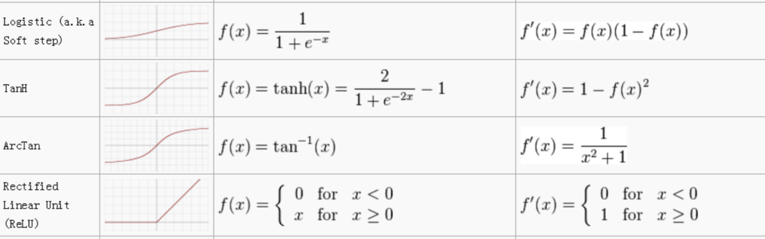
Activation Function
https://towardsdatascience.com/activation-functions-neural-networks-1cbd9f8d91d6

Slide 39
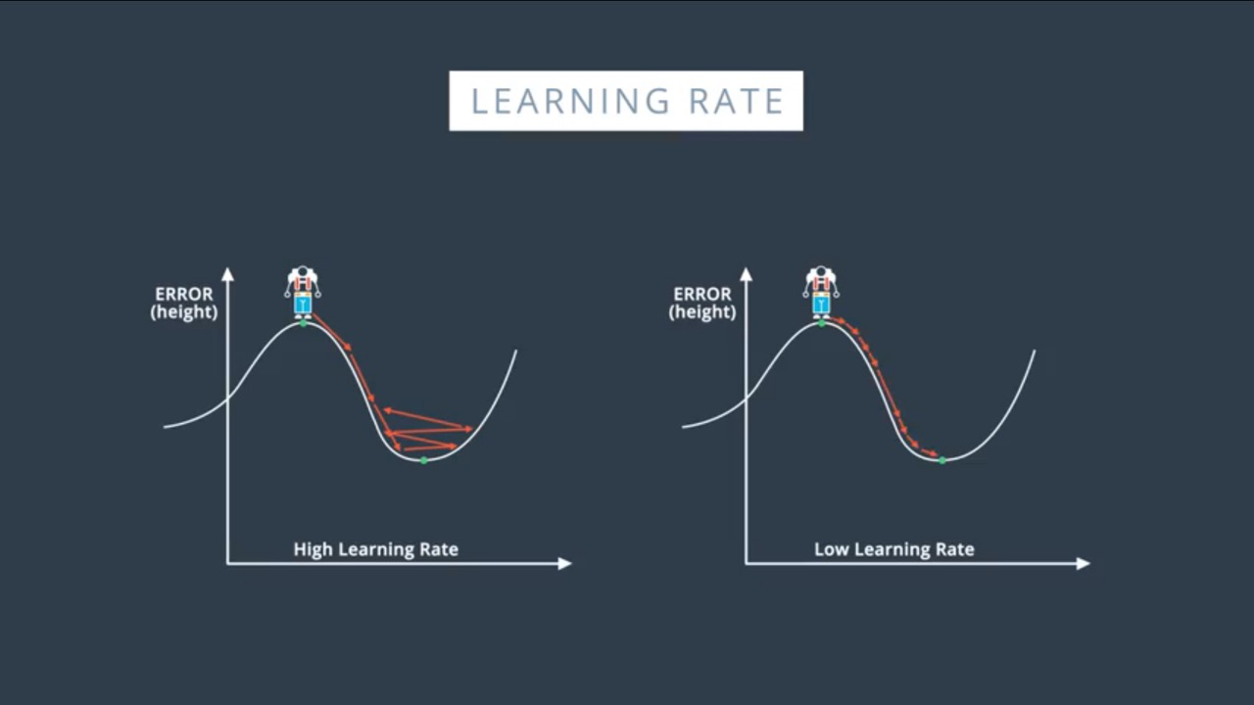
Learning Rate
Learning Rate
More time to reach local/global minima
Learning Rate
Might not reach to minima
Good starting point : 0.01

Slide 40
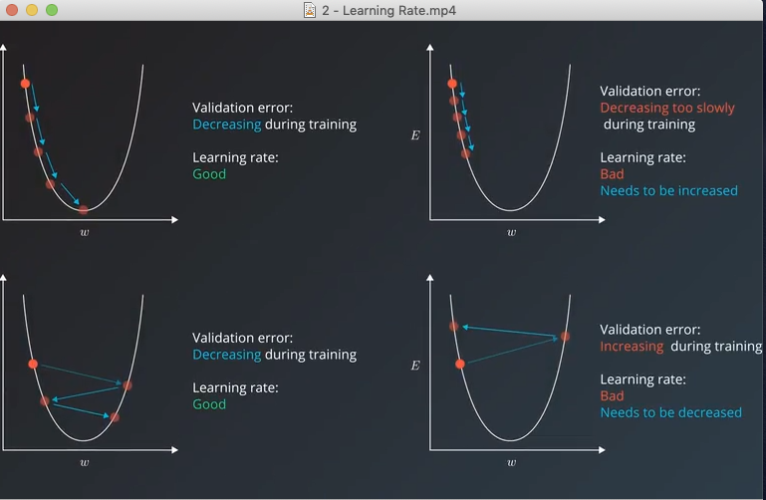

Slide 41
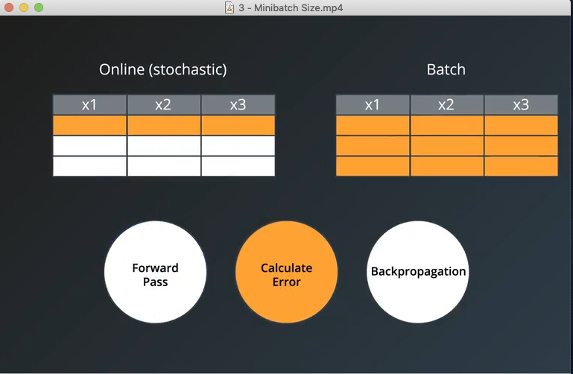
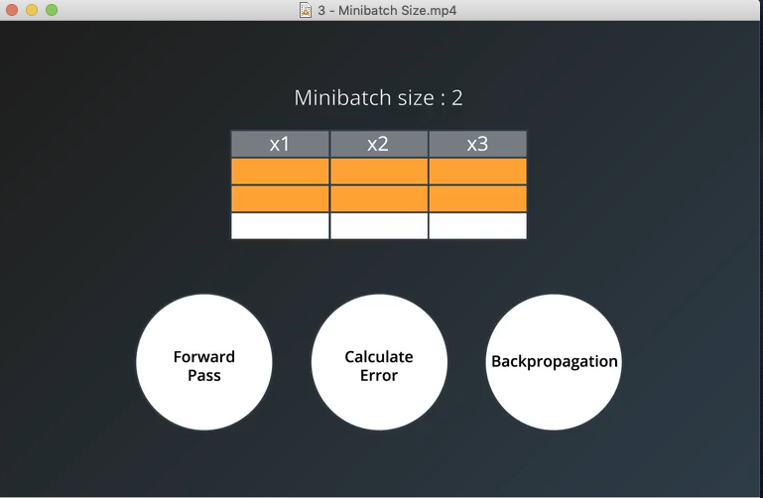
Batch

Slide 42
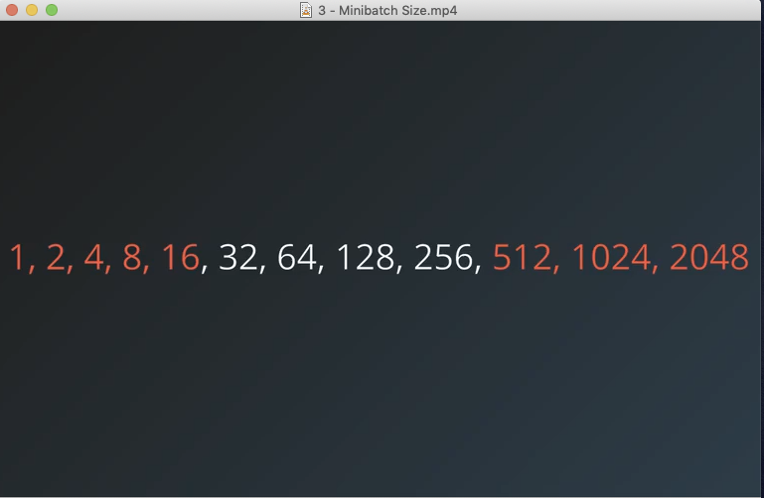
Small batch size – more time to train
large batch size – more computational power

Slide 43
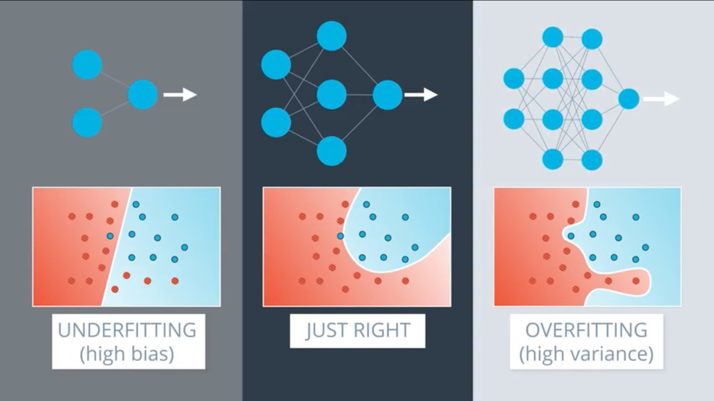
Overfitting

Slide 44


Slide 45

Dropout

Slide 46

Epoch – Number of Iteration

Slide 47


Slide 48


Slide 49


Slide 50
CNN

Slide 51

CNN

Slide 52

CNN

Slide 53



Convolution - Filter
Filter / Kernel
Padding
Stride

Slide 54

CNN

Slide 55


CNN

Slide 56


PyTorch

Slide 57


PyTorch

Slide 58

Transfer Learning

Slide 59

Transfer Learning

Slide 60

RNN
The core reason that recurrent nets are more exciting is that they allow us to operate over sequences of vectors: Sequences in the input, the output, or in the most general case both.
http://karpathy.github.io/2015/05/21/rnn-effectiveness/

Slide 61

RNN
Notes:
Vanishing gradient

Slide 62

LSTM
Other PPT

Slide 63


Slide 64


Slide 65
Paper

Slide 66


Slide 67


Slide 68


Slide 69


Slide 71


RNA-Seq

Slide 72


ChIP-Seq

Slide 73


Slide 74



Slide 75


Slide 76


Slide 77


Slide 78


Slide 79


Slide 80


Slide 81


Slide 82


Slide 83


Slide 84



Slide 85




Slide 86


Slide 87


Slide 88



Slide 89


Slide 90


Slide 93


Slide 94

CNN

Slide 95
CNN

Slide 96
CNN

Slide 97

CNN

Slide 98
CNN

Slide 99

CNN

Slide 100

CNN

Slide 101



CNN

Slide 102


CNN

Slide 103


Slide 104


Slide 105


Slide 106


Slide 108


Slide 109

Number of Hidden Layer

Slide 110

CNN

Slide 111


Slide 112

CNN

Slide 113


Slide 114


Slide 115


Slide 116


